Slide 1


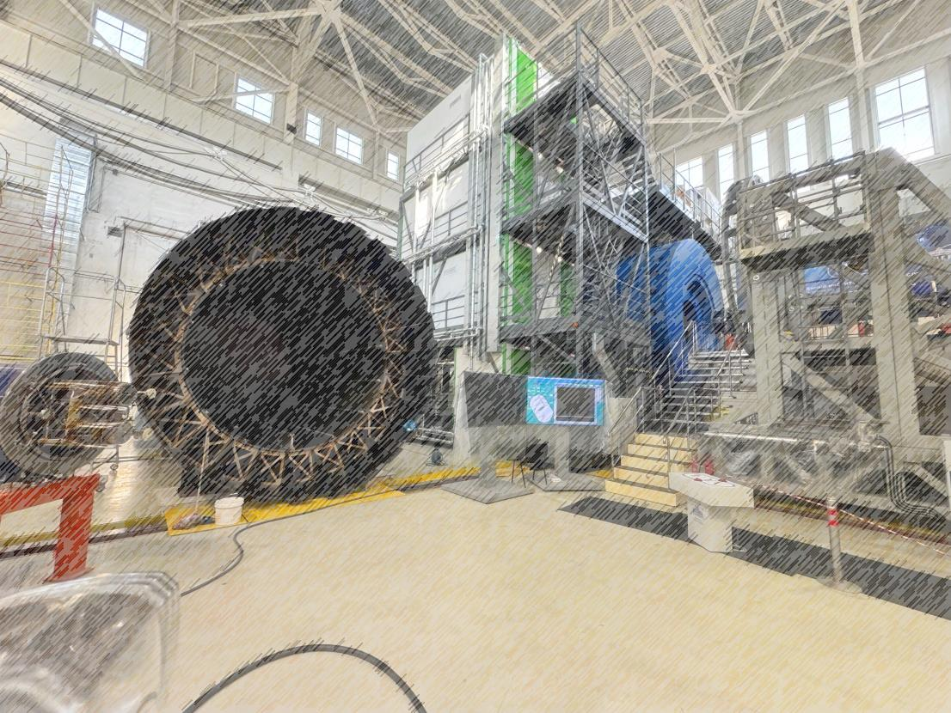
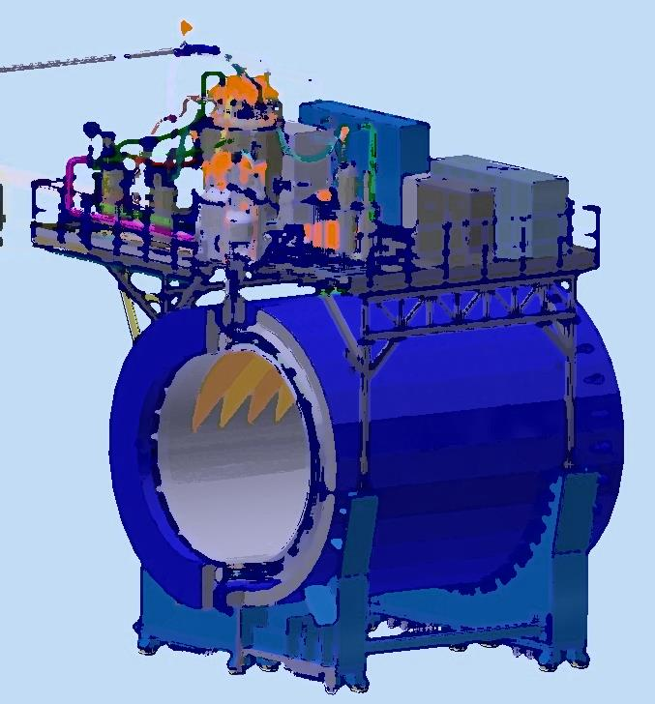
NICA – MPD collider complex
India-JINR Workshop on Particle, Nuclear, Neutrino Physics and Astrophysics
10-12/11/2025
From drawing
to facility
Speaker: K. Mukhin
NISER, Bhubaneswar 2025

Slide 2
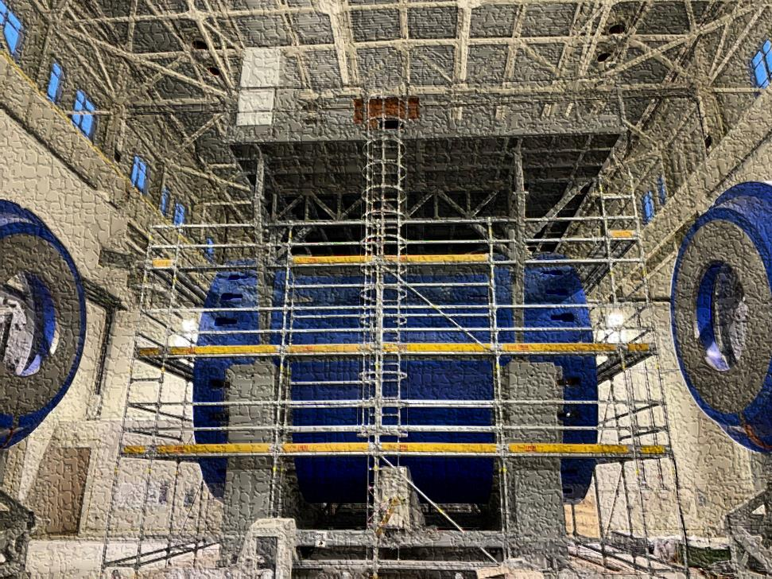
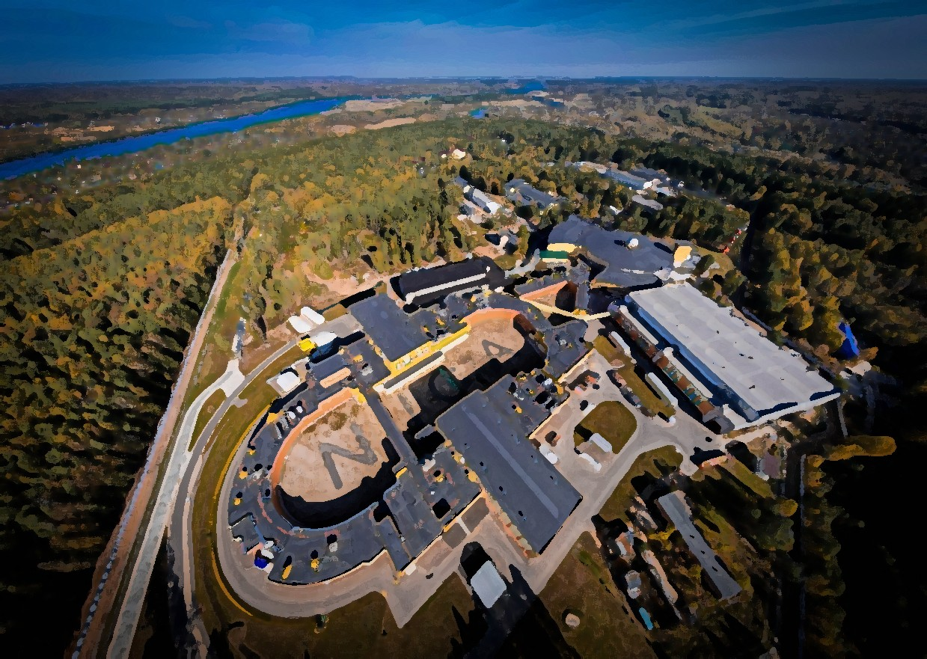
Plan of talk
NICA complex
- Some data of collider units
- Building and engineering system
MPD
- Delivery, magnet construction and some parameters
- Power supplier system
- Cryogenic infrastructure
- Magnetic field mapping

Slide 3
Chapter 1 Nuclotron based Ion Collider fAcility NICA complex

Slide 4
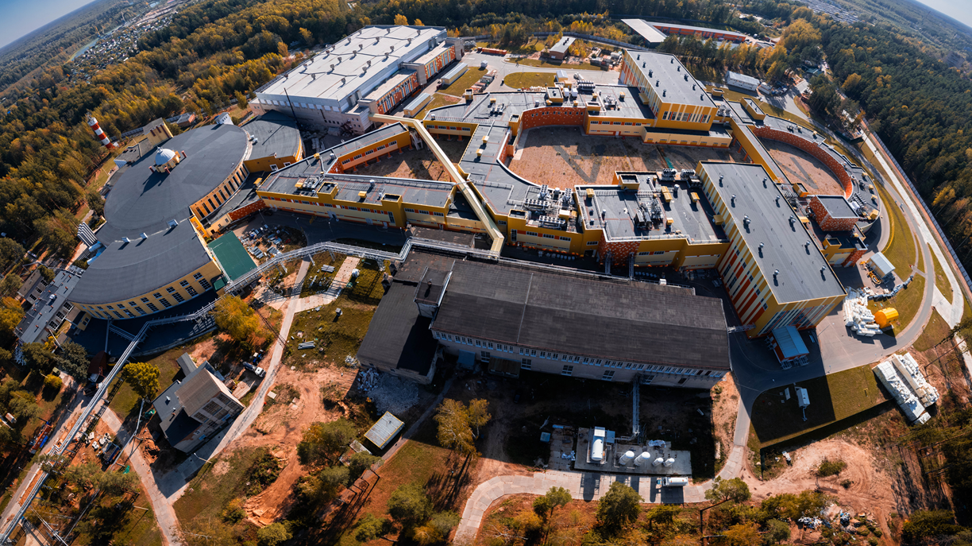
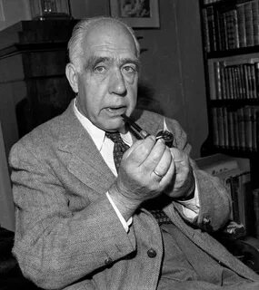
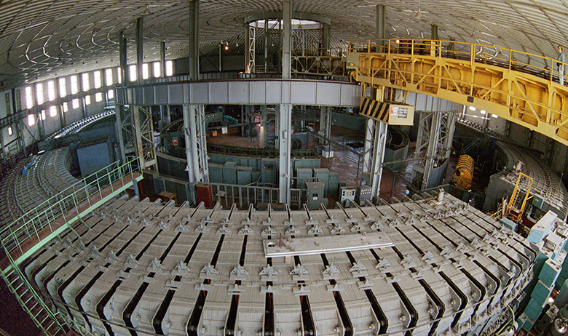
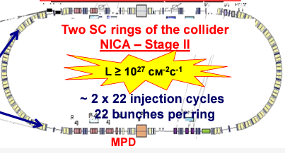
NICA complex and MPD
NILS BOR (1961):
It took great courage, foresight, and, I would say, courage to create such a gigantic and modern instrument.
Start operation in 1957
Proton beam by 10 GeV
Total weight – 36 000 Tons
BM@N
SPD
Booster
Nuclotron
N I C A
MPD

Slide 5
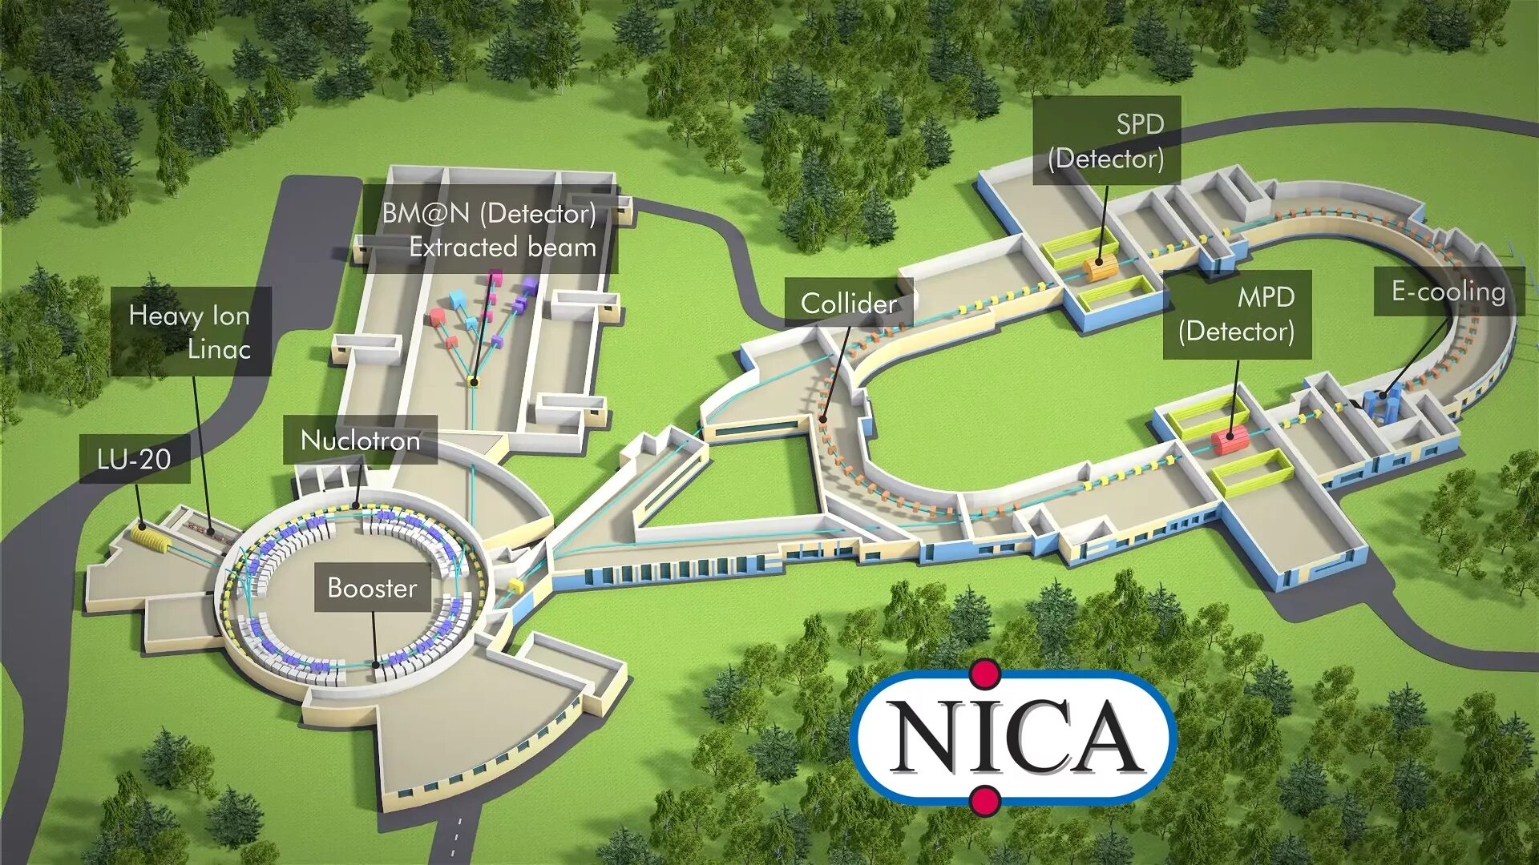
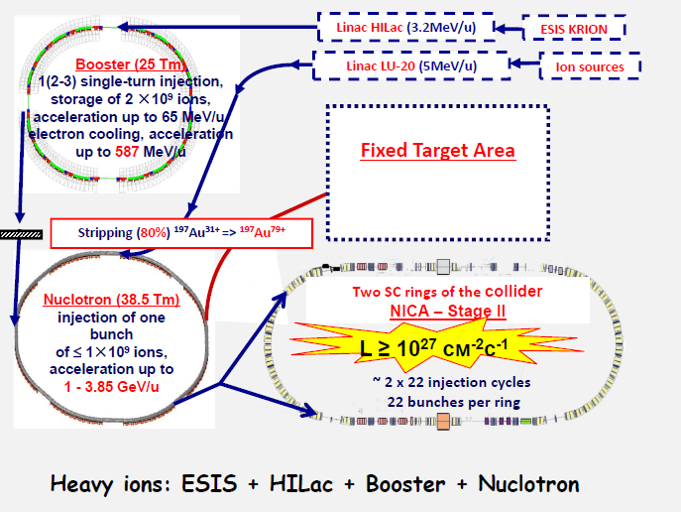
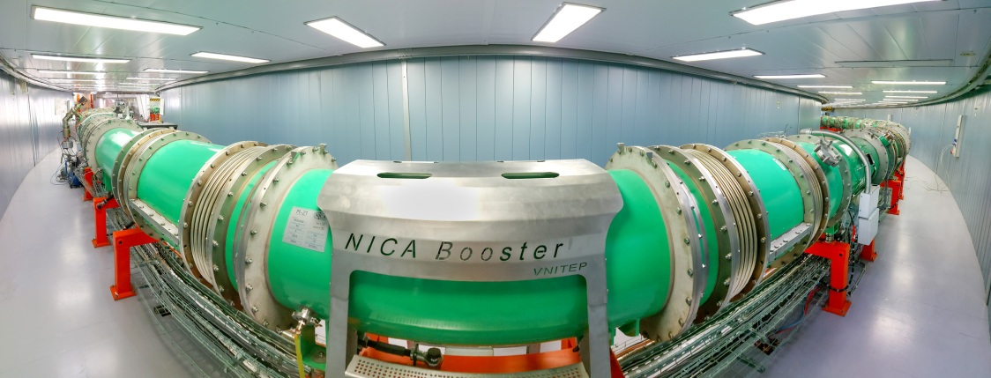
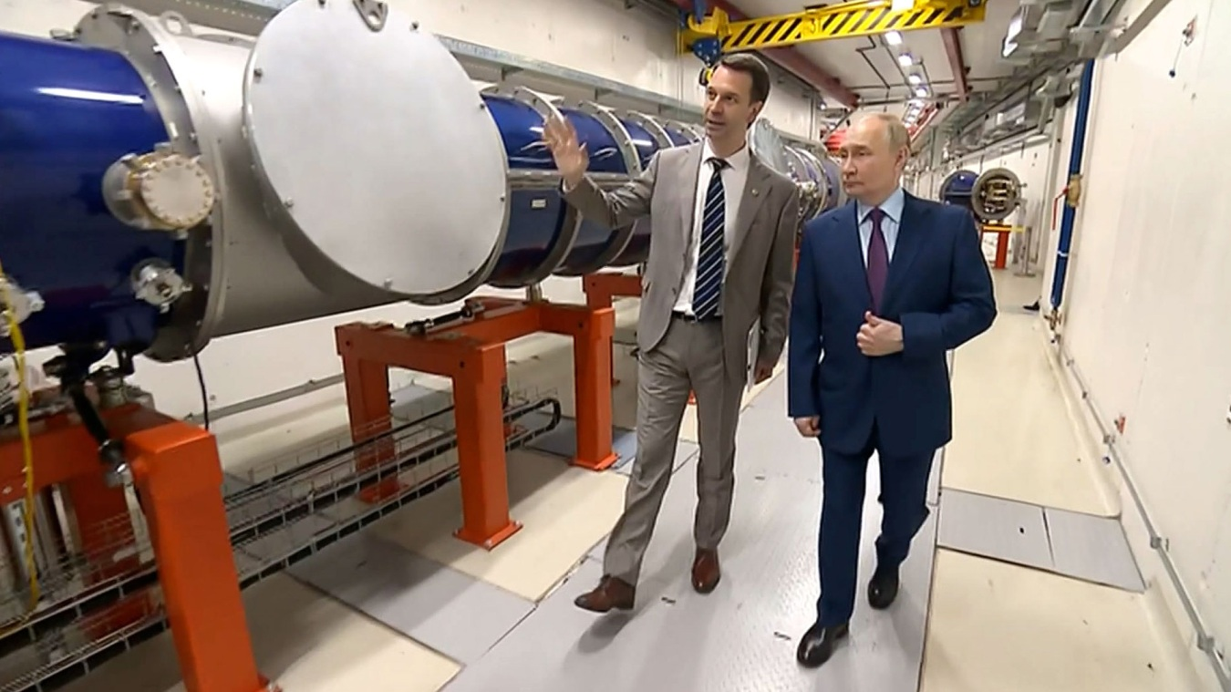
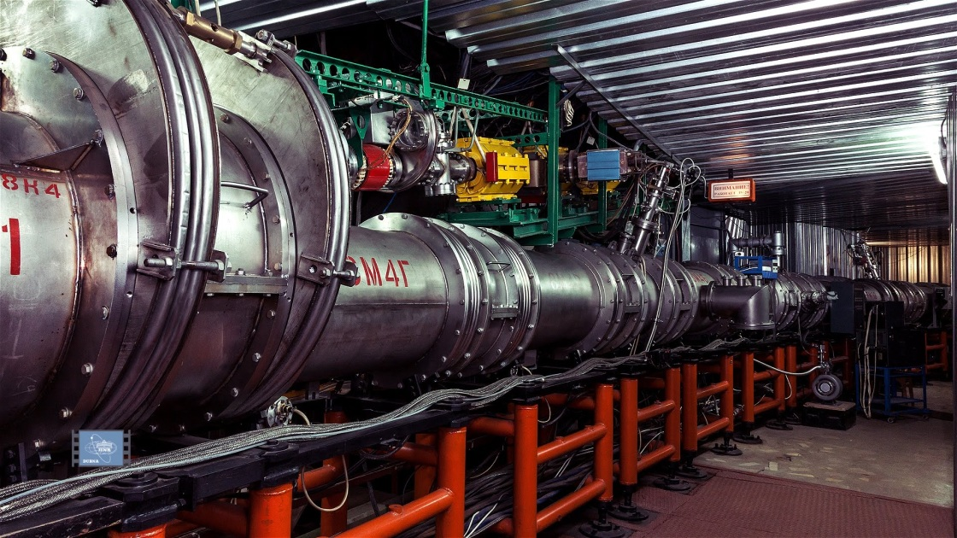
Scheme of Nuclotron based Ion Collider fAcility

Slide 6
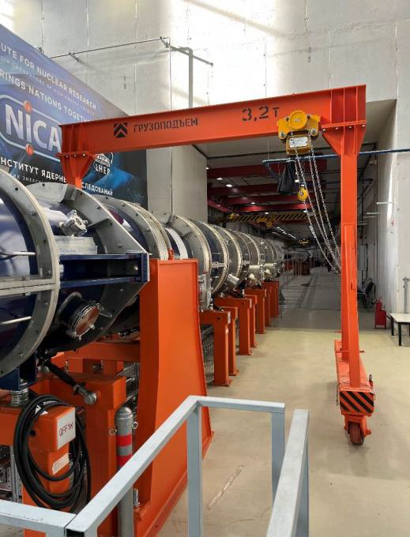
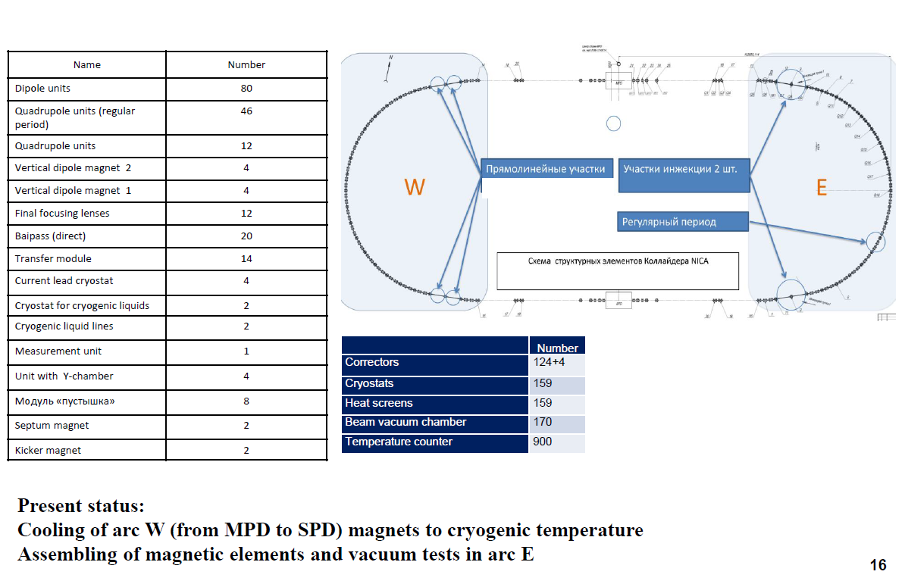
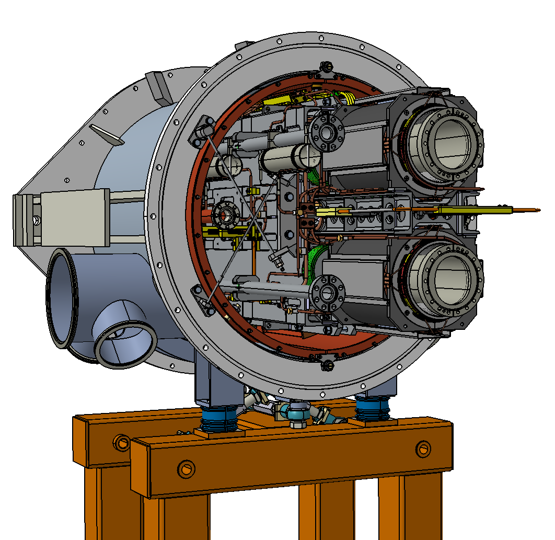
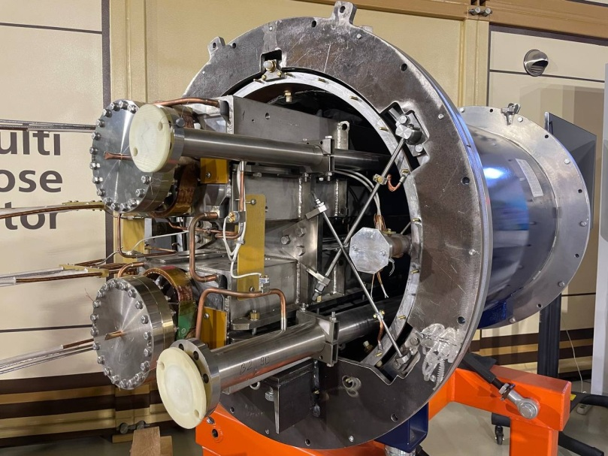
Collider elements

Slide 7
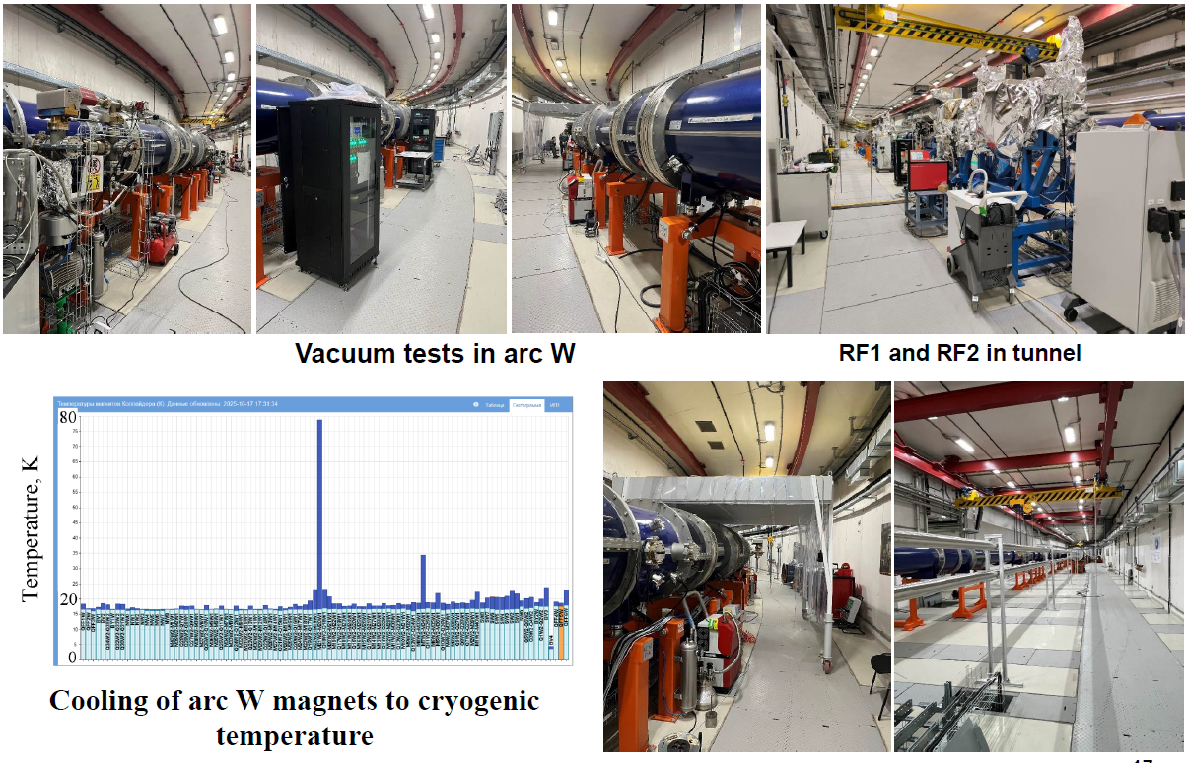
Assembling and tests of Collider equipment

Slide 8
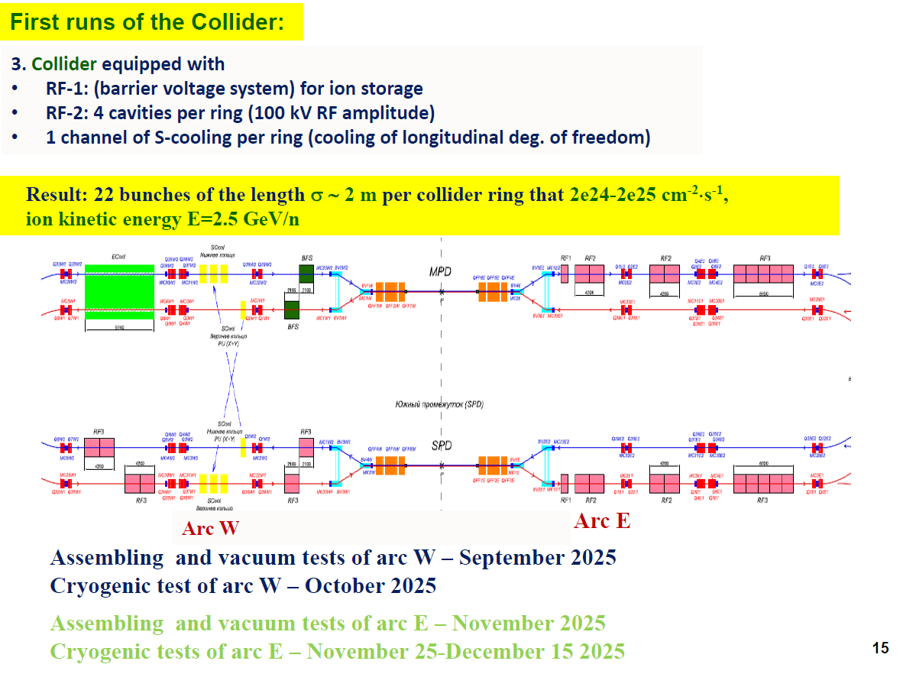
Status and plans of the collider at present day

Slide 9
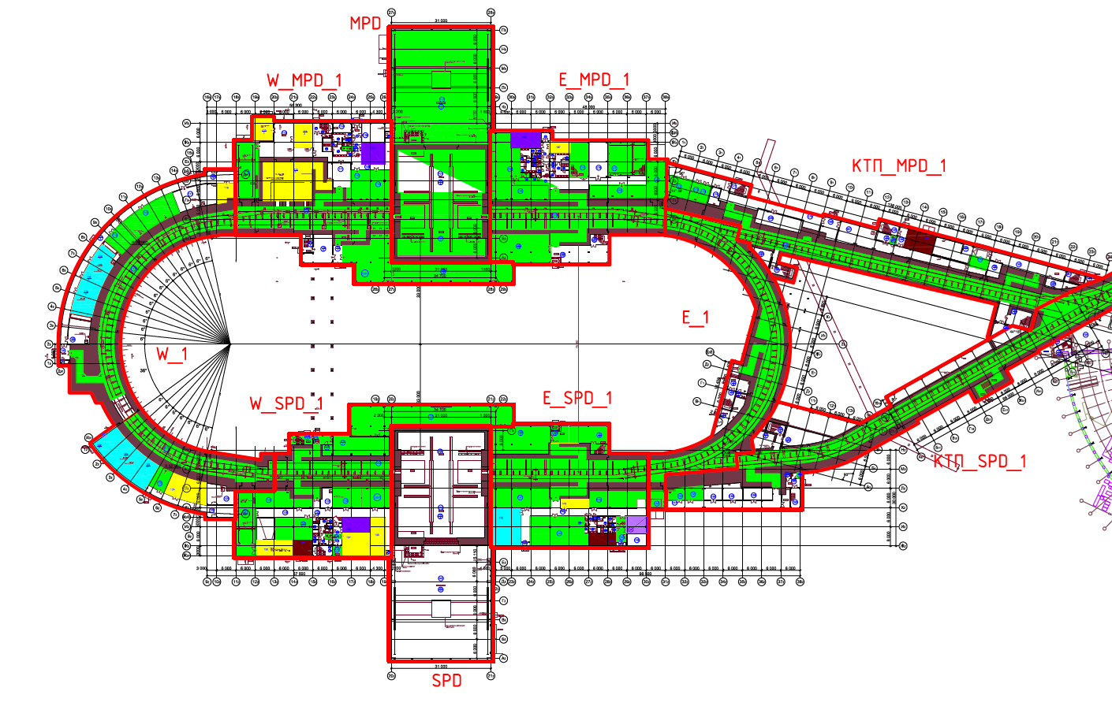
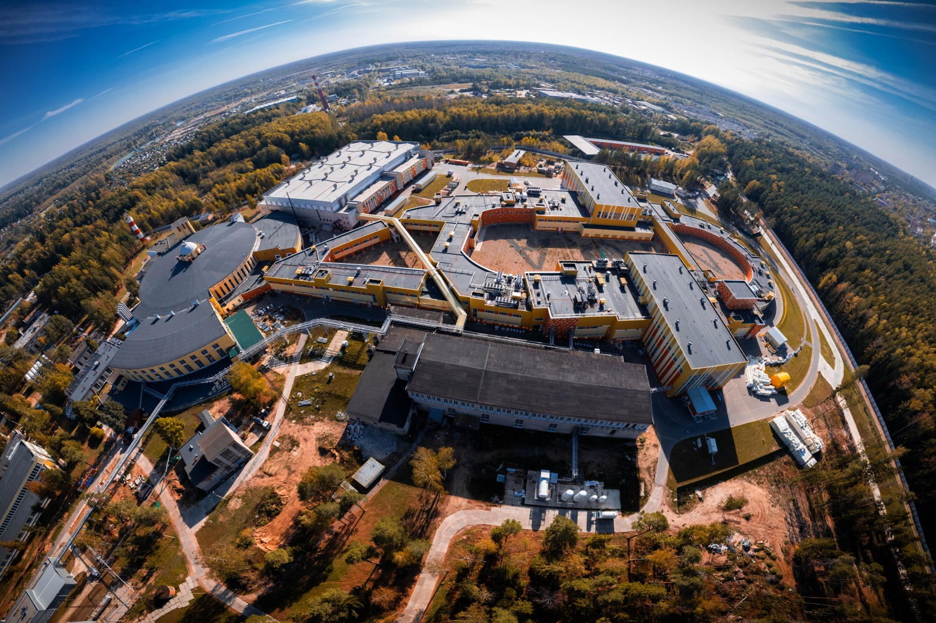
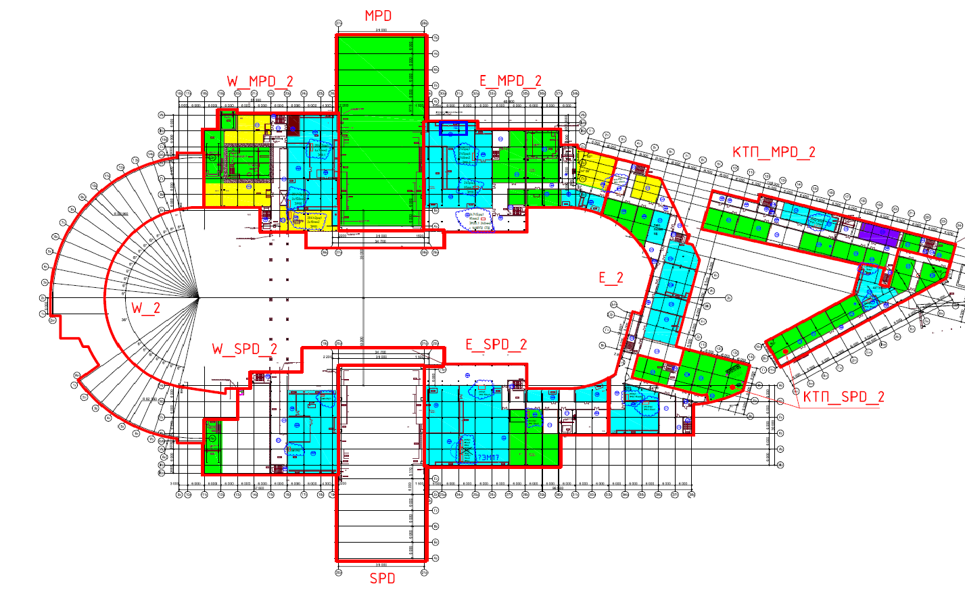
Collider building #17
Ground floor
Some data of building parameters
Total area of the building, m2 | 30 800
Covered area, m2 | 22150
Number of floors | 2
Building construction volume, m3 | 293500
BM@N
Extracted beam
SPD
First floor
Booster and Nuclotron
MPD
Cryogenic area

Slide 10
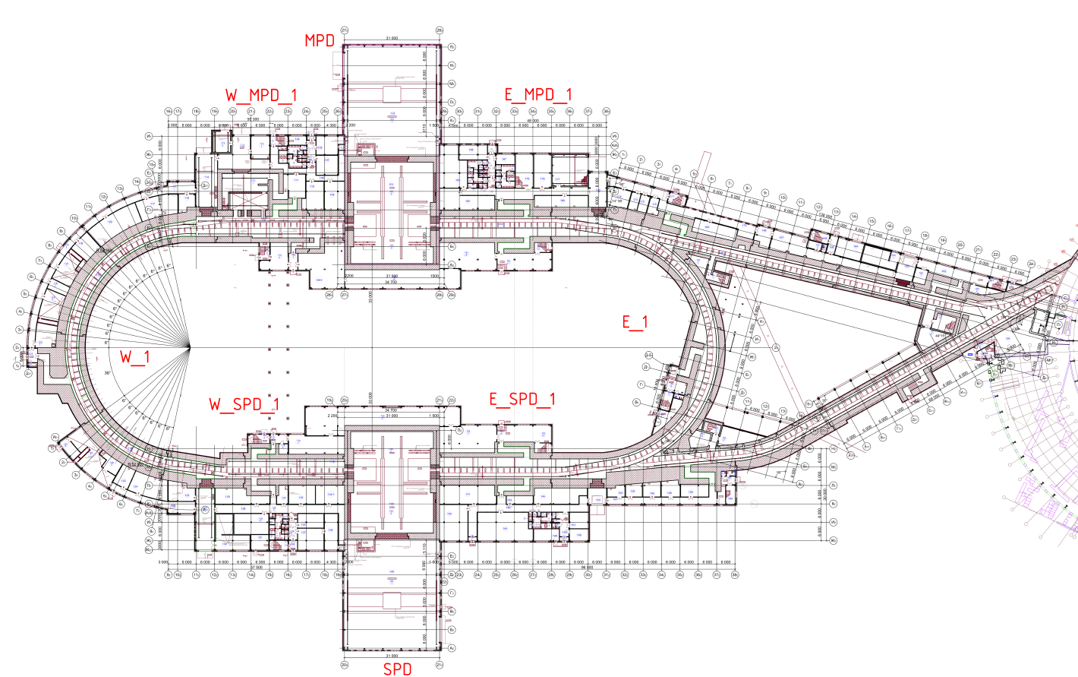
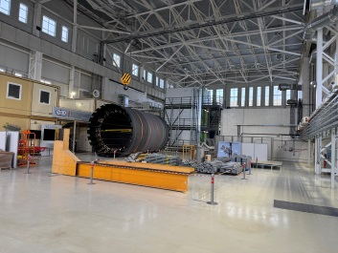
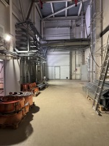
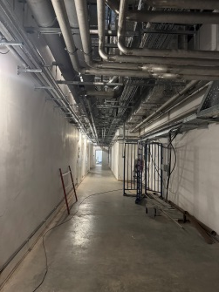
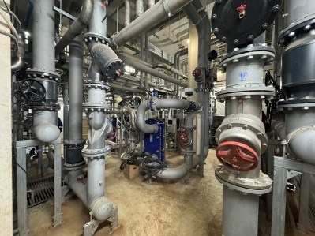
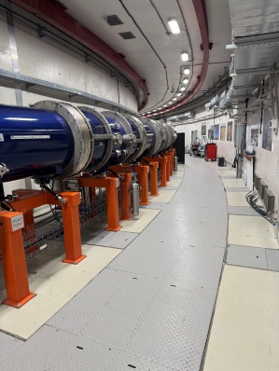
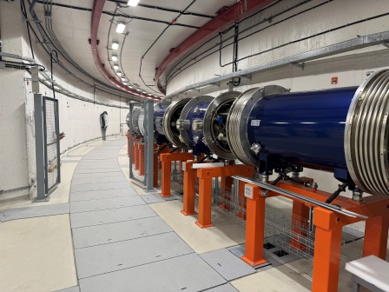
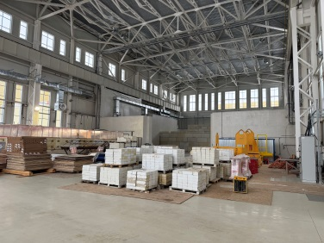
Collider building #17 Ground floor
One of the hallways with engineering communications on the ceiling and entrance gates
MPD hall
Water cooling area
Ground floor parameters
Name | Unit, m²
Tunnel area | 5182
MPD hall | 1996,5
SPD Hall | 1996,5
Electron cooling | 106
Water cooling | 420
Power supply area | 450
Total control rooms (PS, MPD, SPD, EC…) | 180
Engineering equipment technical rooms | 395
Technical staff rooms | 450
Collider tunnel
Collider tunnel

Slide 11
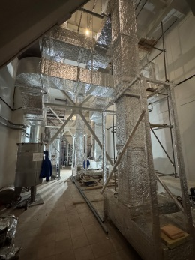
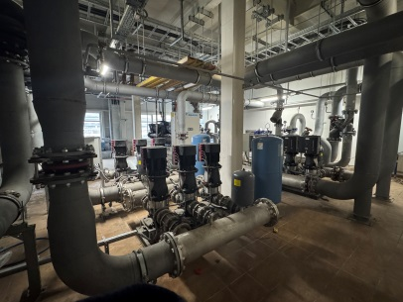
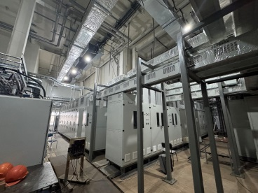

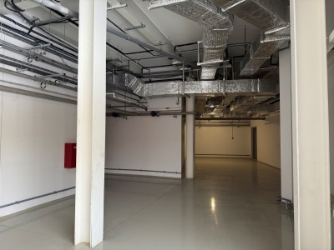
Collider building #17 First floor
Climate control system
First floor parameters
Name | Unit, m²
Electron cooling power area | 380
Water cooling | 210
Power supply area | 450
Office area, temporary collider control rooms | 220
Engineering equipment technical rooms | 5500
Technical staff rooms | 450
Cooling system
Electrical power racks
Control and office rooms
Example of one of the hallways

Slide 12
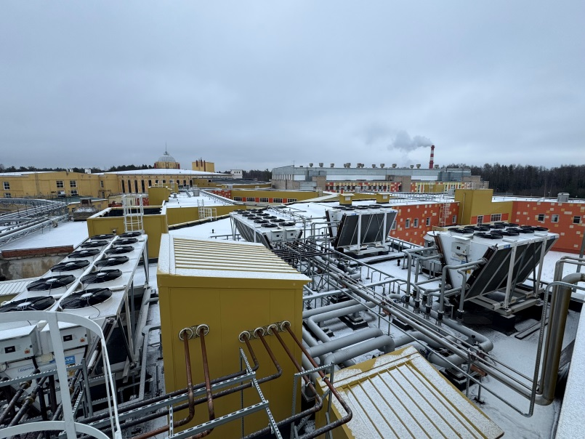
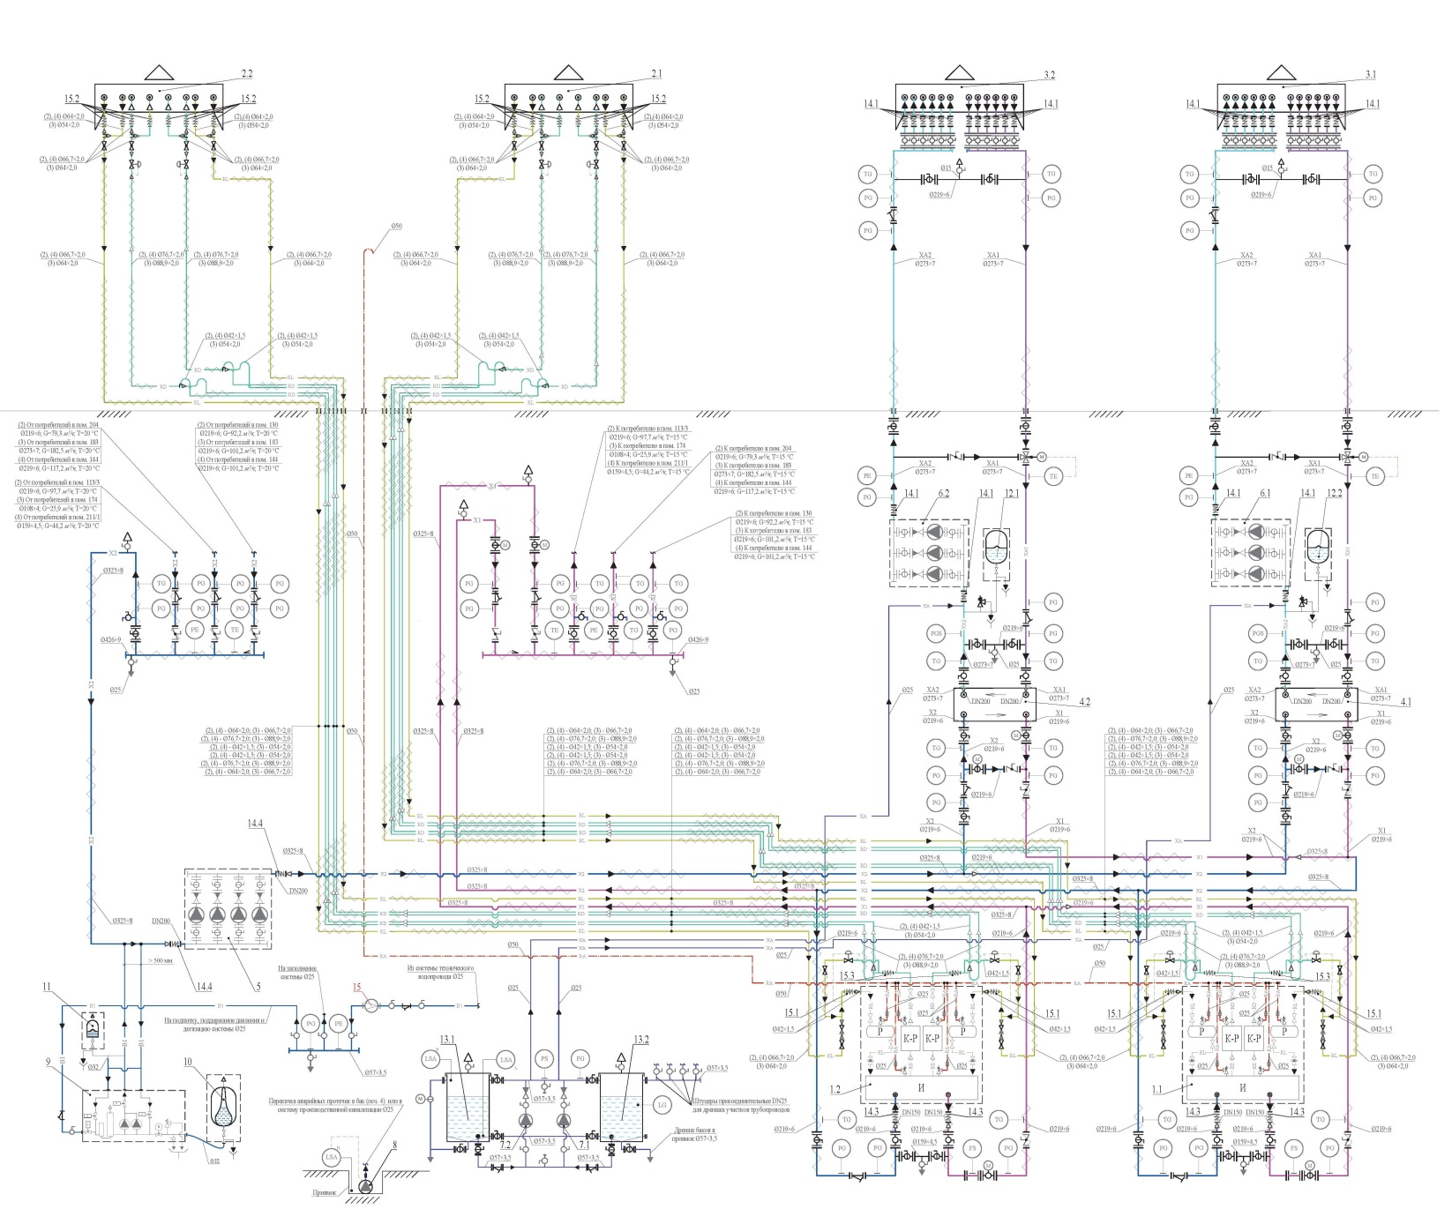
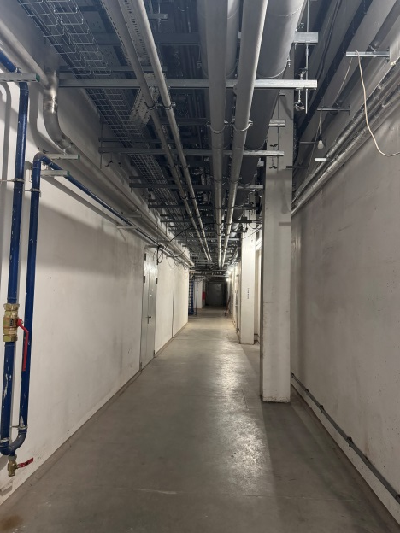
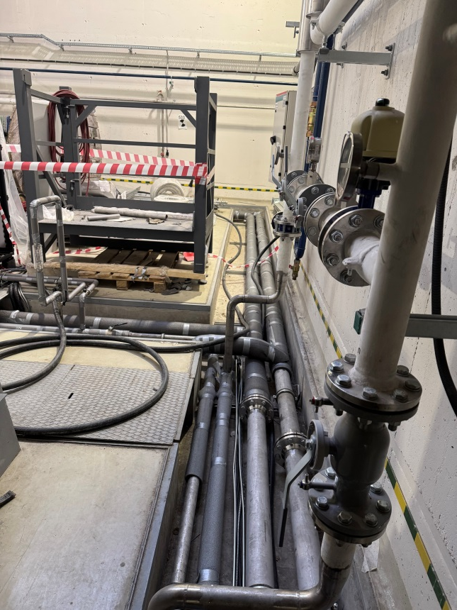
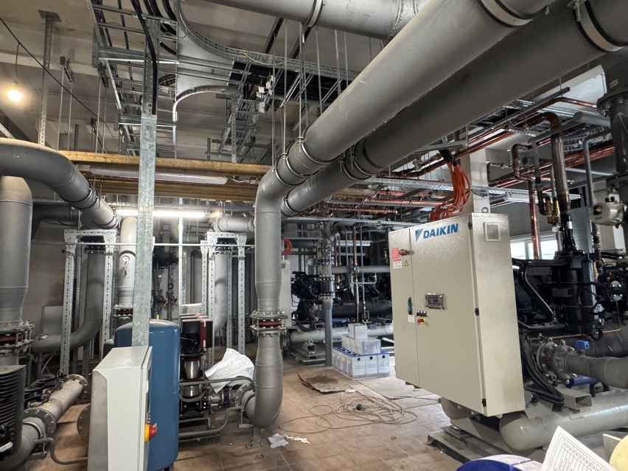
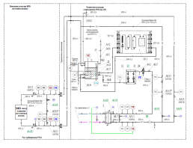
Engineering systems Cooling water system
Water cooling consumers
Electrical power of the collider
MPD detector and subdetectors
Cryogenic and vacuum systems
Electron cooling systems
SPD detector
Dry cooling
Water cooling system including 4 similar cooling centers. Cooling center is complicated and uses 4 different coolants. Three operation options are available depending on the ambient temperature. This scheme allows obtaining stable temperature at the collider and detector equipment in the whole operation range regardless of the season.
Cooling system parameters
Index number of cooling center | 1 | 2 | 3 | 4
Cooling capacity | 1335 kW | 1540 kW | 1290 kW | 453 kW
Refrigerant | Antifreeze, technical water, freon, purified water
Number of consumers | 10 | 10 | 9 | 2
Range of water temperature | 18 - 30⁰C | 15 - 55⁰C | 15 - 25⁰C | 18 - 24⁰C
Operation modes* | Dry cooling, cooling machine, mix mode
* depends on consumers
** depends on ambient temperature

Slide 13
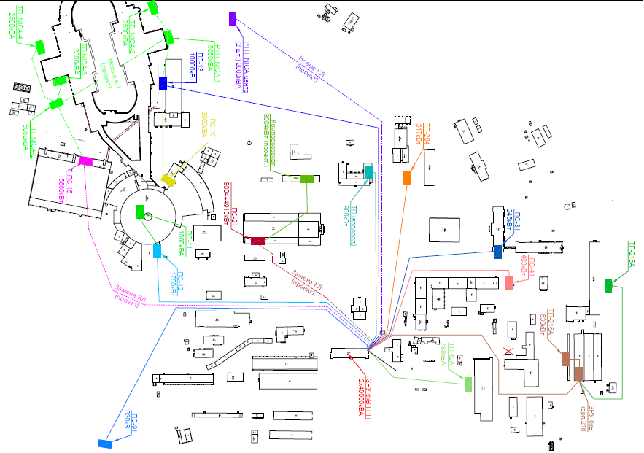
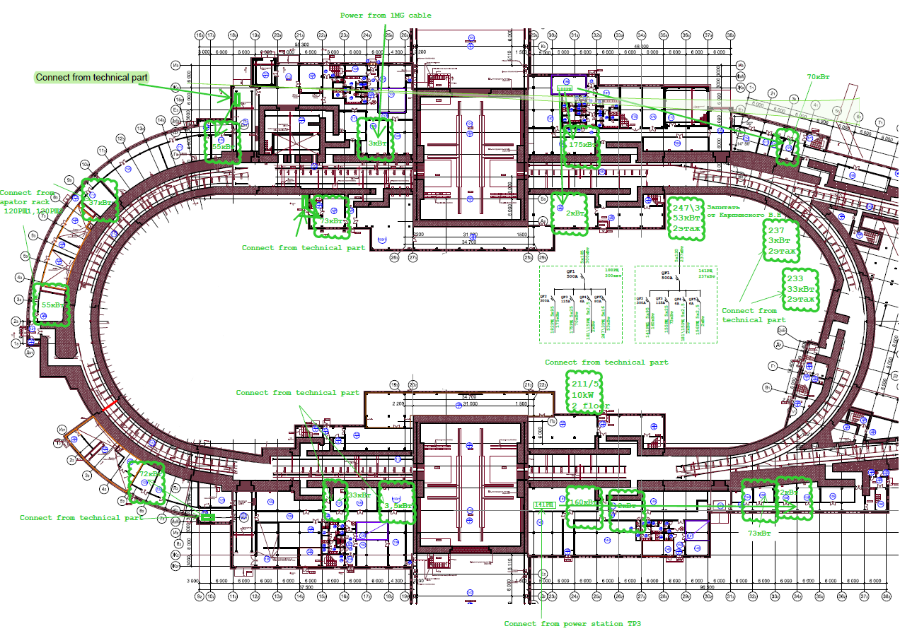
Engineering systems Power electricity of NICA complex
Situational plan of the LHEP site power supply
Total power for NICA – 10000 kW
Include
Transformer substation – 3 un. (2500 kW each (TS 2, TS 3, TS 4))
Distribution substation DS NICA 2 -1 un. (5050 kW (supplies TS 3, TS 4))
Distribution transformer substation DTS NICA 1 – 1 un. (5050 kW (TS 2))

Slide 14
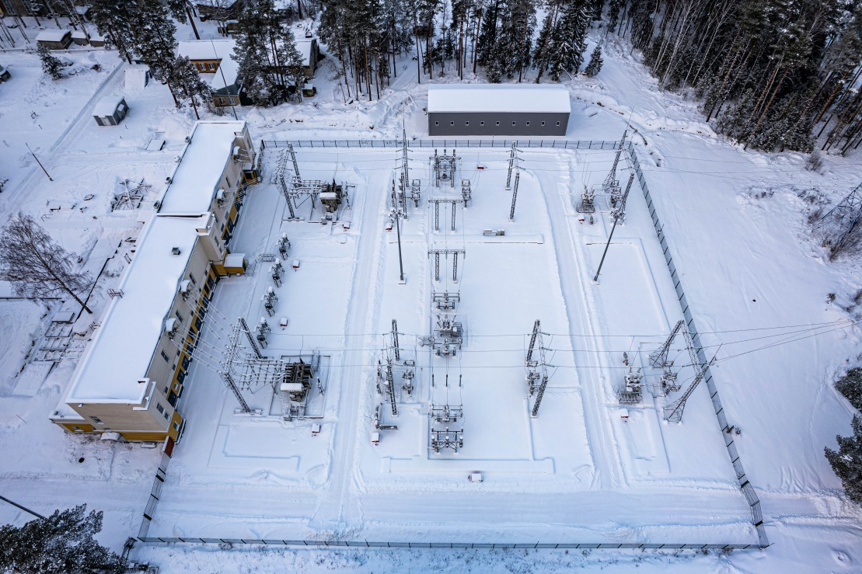
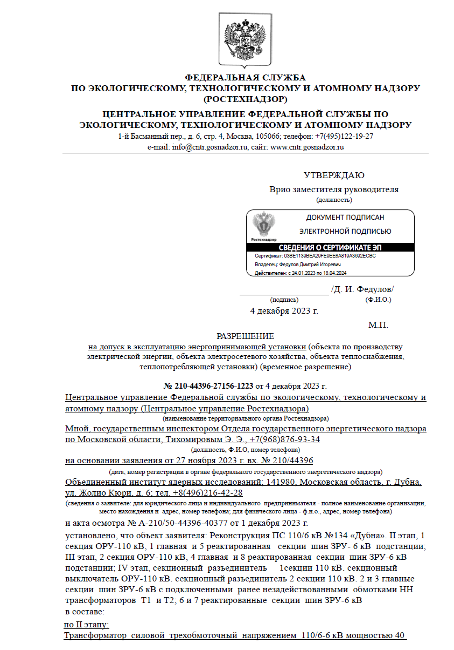
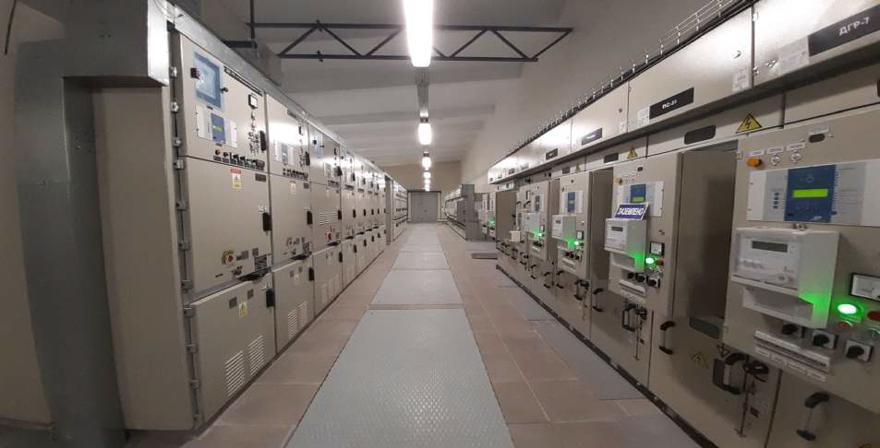
Main power station GGP1
Upgrade of the GPP 1 was the twofold increase in electricity power.
From 22396 kV (40 MW) to 40800 kV (80 MW).
Out of the 40800 kV, 34300 kV for JINR and 6500 - for Dubna city.
The final successful commission from Rostechnadzor was carried out
Permission
for admission to the operation of a power receiving unit

Slide 15
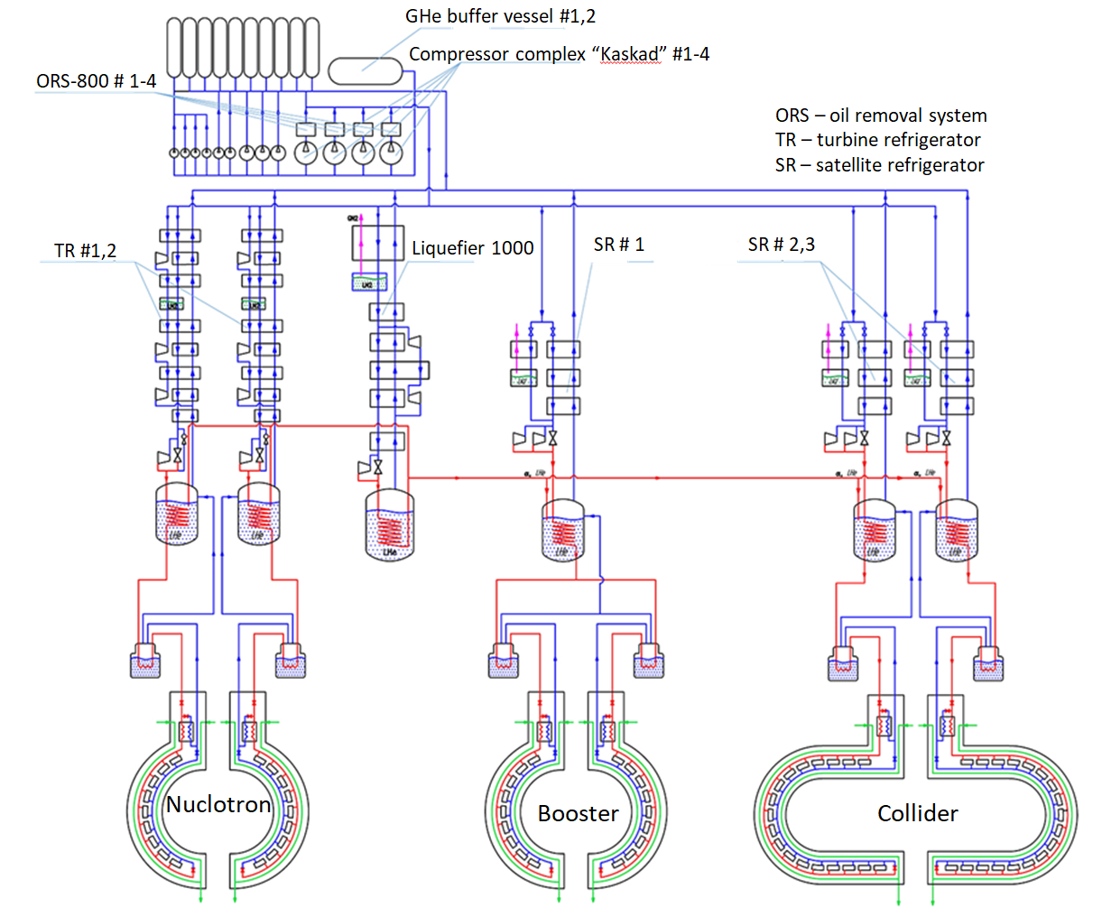
Cryogenic system of NICA complex Ready for the technical launch of the collider in 2025
Scheme of cryogenic NICA complex
The main goal of the cryogenic department for 2025 is to ensure the cooling of all rings of the NICA complex, as well as the operation of liquid helium consumers (Cryon, MPD, magnet test stand).
Main cryogenic equipment of the
NICA complex
3 Satellite refrigerators (each cooling capacity is 2000 W at 4.5K);
2 Turbine refrigerators (each cooling capacity is 2000 W at 4.5K);
Liquefier (capacity of LHe is 1000 l/h)
Compressor complex;
Oil removal system for each of the compressor
Cryogenic LN2 and LHe pipes
Warm straight and return pipelines
Nuclotron
*Drawings and information by A. Konstantinov

Slide 16
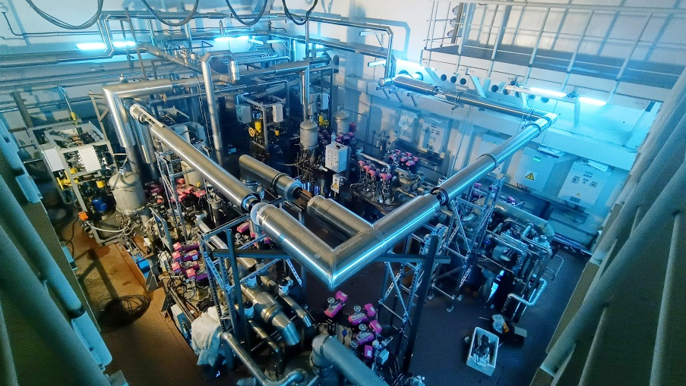
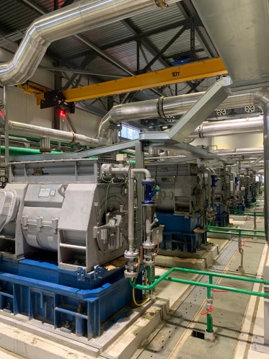
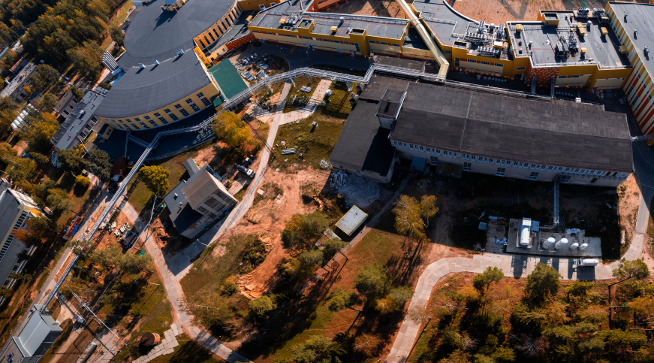
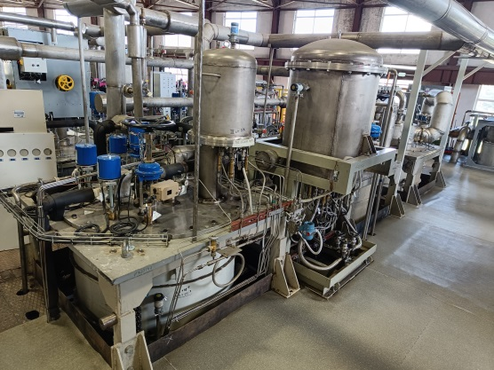


Cryogenic system of NICA complex Ready for the technical launch of the collider in 2025
Satellite refrigerators in the collider building
Liquefier 1000 and compressor complex
Cryogenic LHe, LN2, warm straight and return pipelines
- Liquefier 1000 successfully operated at the MPD detector cooling during the run, filling 12 m3 of tank containers with liquid helium.
- The staff of the cryogenic department optimized the starting modes of the liquefier, which reduced the cooling time of the tanks and reduced energy costs.
- Liquefier has confirmed the design capacity of 1000 l/h of liquid helium.
- Two new compressors “Kaskad -110/30” successfully operated during the MPD cooling session.
- To cool the collider, 2 satellite helium refrigerators #2, 3 were installed in room 177 of collider building #17.
- In December 2024, they were successfully launched with cooling to the temperature of liquid helium.
- The cooling capacity of each unit is 2000 W at 4.5 K.
- In January, the refrigeration control circuits will be adjusted.
LHe
LN2
- Warm pipe is ready and tested.
- LN2 pipes are progressing as planned and will be finished in January 2025.
- LHe pipe in the west side
- LHe pipe in the east side
*Drawings and information by A. Konstantinov

Slide 17


Histogram of cooling of collider magnets 17/10/2025
W
E

Slide 18
Chapter 2 Multi-Purpose Detector MPD at NICA complex

Slide 19




Magnet dimensions and delivery
Genoa (Italy) – St. Petersburg (Russia) – Ladoga and Onega lakes – Volga river – Dubna (JINR)
The parameters for the transport of the MPD Magnet are:
• MPD Magnet weight: 80 ton
• Shipping structure weight 45 ton
• MPD Magnet dimensions without Shipping Structure (L x Ø) 8.2 x 5.9 m
• Overall dimensions (L x W x H) 9.4 x 7.2 x 6.6 m
• Total weight 125 ton
• Max tilt allowed 1 degree

Slide 20


MPD magnet construction
Parameters of the magnet
Magnetic field | 0,57 T
Cryostat weight and size (diameter/length) mm | 66 tons 5443/7910
Yoke weight and size (diameter/length) mm | 630 tons 6583/8970
Current Voltage | 1790 A 10V
Each pole weight | 45 tons
Total weight with support equipment | 800 tons
Homogeneity | 3*10⁻⁴

Slide 21



Possibility of magnet moving
Three main position
Assembling position
Trim coils installation position
Beam position
Distance – 12 m
Moving time about 5 hours
Speed 2 – 3 mm/s (for the final step 0,4-0,5 mm/s)

Slide 22



Solenoid construction
Solenoid with vacuum jacket
Solenoid without vacuum jacket
LN2 shield
4, 5
9
3
Vacuum jacket
Parameters of solenoid
Vacuum jacket (10-5 Torr in warm mode)
LN2 thermal shield (80K)
Cold mass (support cylinder for SC cables)
Superconductor cables (3 parts) total length 27 km, NbTi in pure aluminum matrix.
Cooling LN2 and LH pipes (cimmny area)
6. Number of turns – 1674
7. Operation temperature 4,5 – 5,5 K
8. Operation current / Rated induction – 1,79 A / 0,5 T.
9. 12 Radial and 6 axis cold mass suspensions
10. Total heat gain – 1056 W
Inner diameter is 4656 mm
Outer diameter is 5443 mm
Length is 7910 mm

Slide 23




Suspension system of cold mass
Suspension system consist of 6 axils and 12 radial tie-rods.
Axis tie-rods – fixed cold mass from moving in axis direction
Maximum force of tensile/compressive is 240/89 kN. Safety factor is 4,3.
Radial tie-rods – supporting a cold mass inside vacuum vessel.
Safe against shear + bending with the sizing load of 50 kN. Safety factor 1,8.

Slide 24






Superconductor cable
Original SC cables for MPD
Winding and tests of SC cable in ASG
LHC 27 km
SC cables parameters
SC Materials – NbTi/Cu.
Cable composition is pure aluminum matrix (4,1 x 20 mm) and inside string of Cu/SC ratio 0,9/1 (d – 1,5 mm).
Insulation – kapton tape, glass tape and epoxy resin.
Critical current (1,2 T, 4,5 K) – 6,9 kA
Cable length - 27 km.
Cable weight – 6,3 tons

Slide 25




Power supply system

Slide 26









Stability test of power supplies
Power supply of TRIM1
I = 3000A V= 70V
Power supply of solenoid I = 2500A V= 10V
Power supply of TRIM2
I = 1300A V= 45V

Slide 27




Cryogenic infrastructure
Control Dewar
Refrigerator
NTCS (Nitrogen temperature correction system)
LN2 and LHe heaters
LHe pipe
Cryogenic flexible connection pipes
LN2 Tanks (2 pc)
LHe Tanks (2 pc)
LN2 transfer pipe 120 m
Warm pipes for He, N2 and instrumentation Air
Flexible warm pipes
Support system for flexible pipes

Slide 28


Cooling process scheduled
Total cooling time – 28 days
Nitrogen mode – 14 days
Transient mode – 6 days
Helium mode – 8 days

Slide 29




Stationary magnetic field monitors
Current 1050A

Slide 30






Field mapper in solenoid
From 06/10/2025 assembling and test in MPD solenoid
16/07/2025 test mapper in Novosibirsk
04/09/2025 mapper was delivered to MPD hall
26-27/10/2025
Measuring in one stationary point (730,6 A)

Slide 31

Timeline
NICA
November – December 2025 – finalisation of assembling,
cold and electrical test
Jenuary – February 2026 – first ion Xe beam in to collider
March 2026 – singl bunch and bunch collision
March – June 2026 – technical stop
From Julay 2026 – collider start operation to detectors
MPD
December 2025 – mapping, processing of results and confirmation of homogeneity (3*10-4) by 0,2 – 0,25 T
Jenuary - February 2026 – mapping of the field 0,3 – 0,5 T
From March 2026 – installetion support cylinder and start assembling detectors

Slide 32

Thank you for attention

