Slide 1
India-JINR Workshop on
Particle, Nuclear, Neutrino Physics and Astrophysics
10 - 12 November 2025
National Institute of Science Education and Research, Bhubaneswar
Nuclear Reaction Channels in Heavy Ion Collisions
A.K. Nasirov^{1,2,4}, B.M. Kayumov^{2,3}, E.D. Khusanov^{2,4}, G.A. Yuldasheva²
¹Bogoliubov Laboratory of Theoretical Physics, JINR , Dubna, Russia
²Institute of Nuclear Physics, Academy of Science of Uzbekistan
³New Uzbekistan University, Tashkent, Uzbekistan ⁴ National University of Uzbekistan, Tashkent
NISER,November 10, 2025

Slide 2
Content
Introduction
Main reaction channels in heavy ion collisions at the around Coulomb barrier energies.
The initial conditions of the entrance channel determining yield of the reaction products.
Nature of hindrance in complete fusion of the massive nuclei in heavy ion collisions.
Mechanisms of the incomplete fusion.
Conclusions.

Slide 3
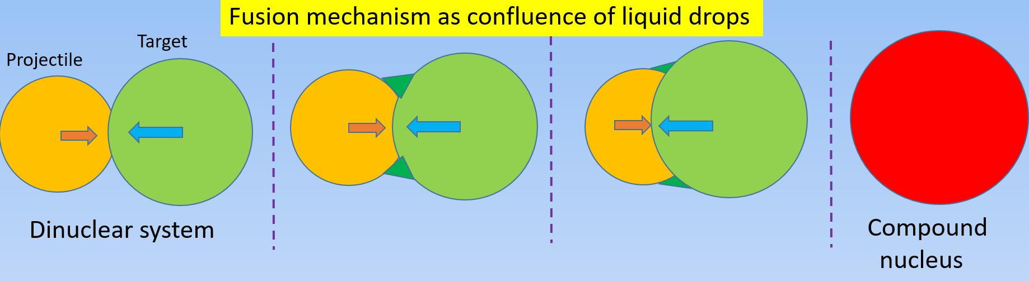
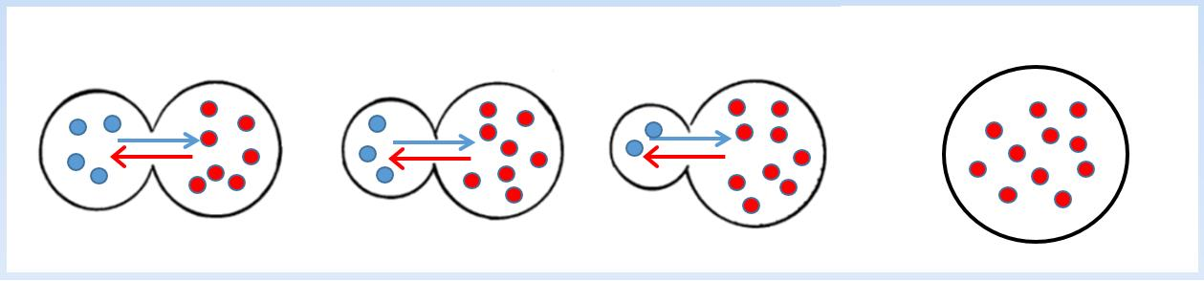
Two different mechanisms of the complete fusion.
Multinucleon transfer mechanism of the complete fusion

Slide 4
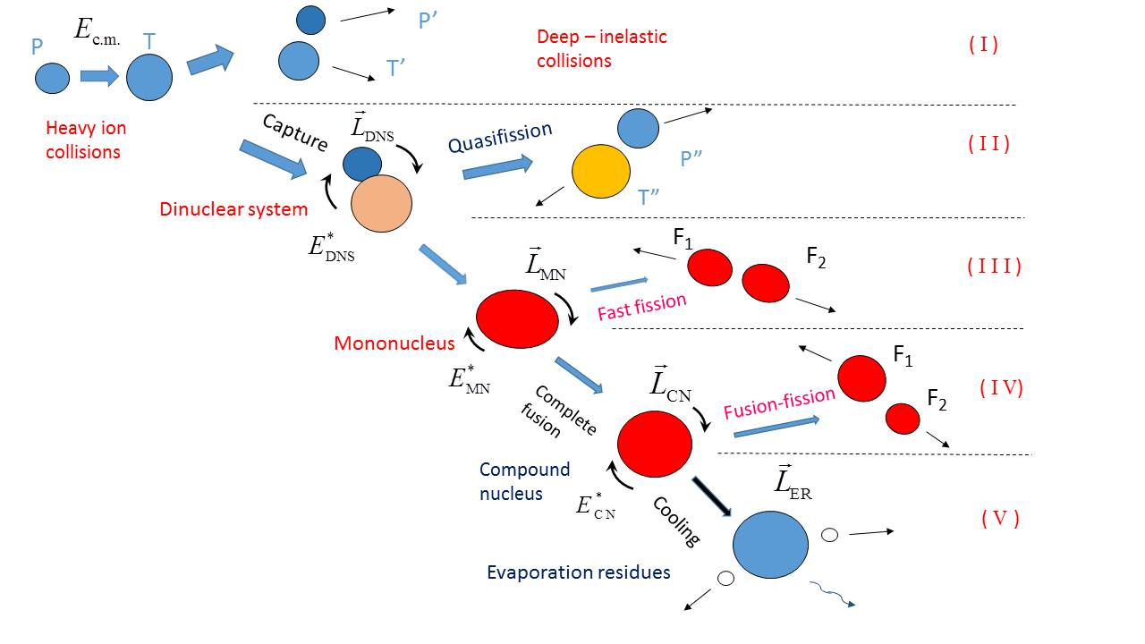
Main reaction channels of the heavy ion collisions
Incomplete fusion
L_{ICN}
E*_{ICN}
⁴⁸Ca+²⁴⁸Cm
(A₁+A₂)/2=148
F₁
Experiment
of Flerov Lab.
JINR, Dubna
F₂

Slide 5


Main reaction channels of the heavy ion collisions
Incomplete fusion
L_{ICN}
E*_{ICN}
⁴⁸Ca+²⁴⁸Cm
(A₁+A₂)/2=148
F₁
Experiment
of Flerov Lab.
JINR, Dubna
F₂

Slide 6
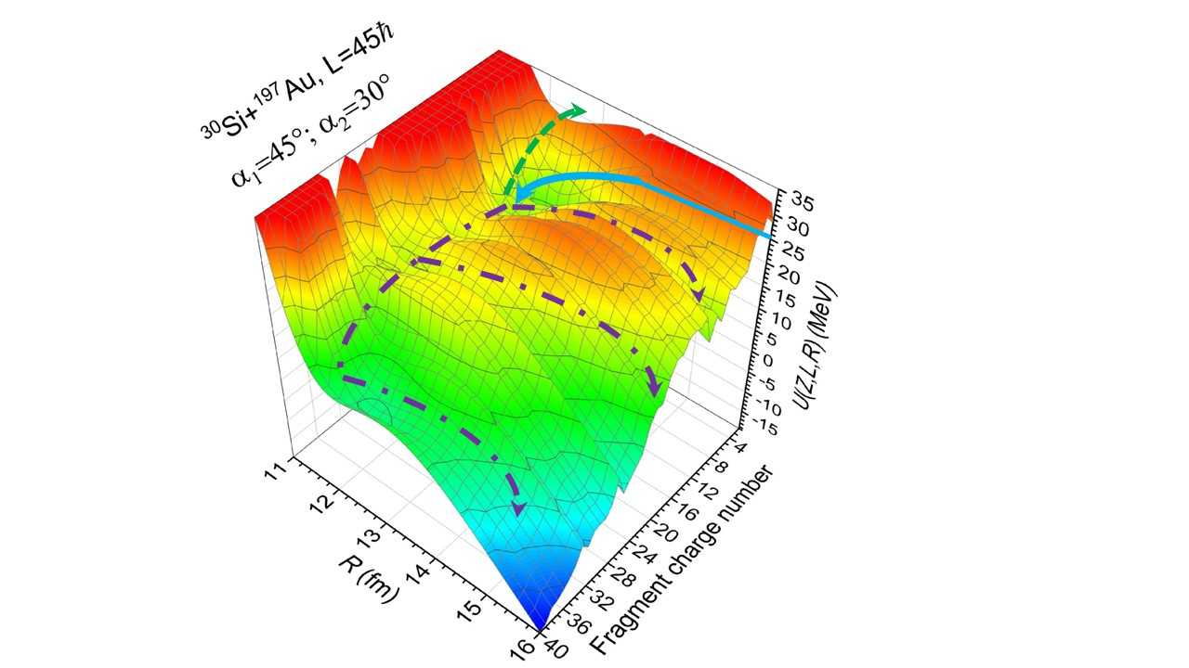
Association of the different mechanisms of the reaction channels with potential energy surface of the dinuclear system formed at capture.

Slide 7
Reactions leading to synthesis of superheavy elements.

Slide 8
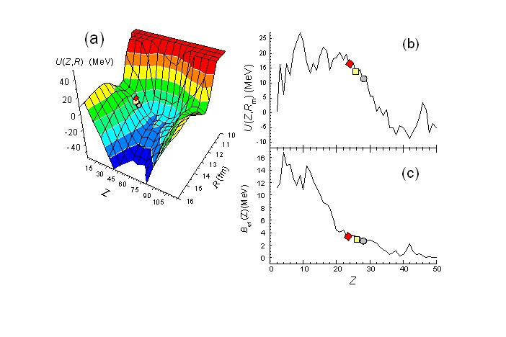
Quasifission and fusion-fission in reactions with massive nuclei: Comparison of reactions leading to the Z = 120 element A.K. Nasirov, et al. Phys. Rev. C 79, 024606 (2009).
50Ti + 249Cf
54Cr + 248Cm
58Fe + 244Pu
64Ni + 238U
Reactions | E_{c.m.}(MeV) | Evaporation residues cross section (pb)
50Ti + 249Cf | 225 | 4 x 10⁻²
54Cr + 248Cm | 236 | 2 x 10⁻³
58Fe + 244Pu | 252 | 7 x 10⁻⁴
64Ni + 238U | 275 | 2 x 10⁻⁶

Slide 9

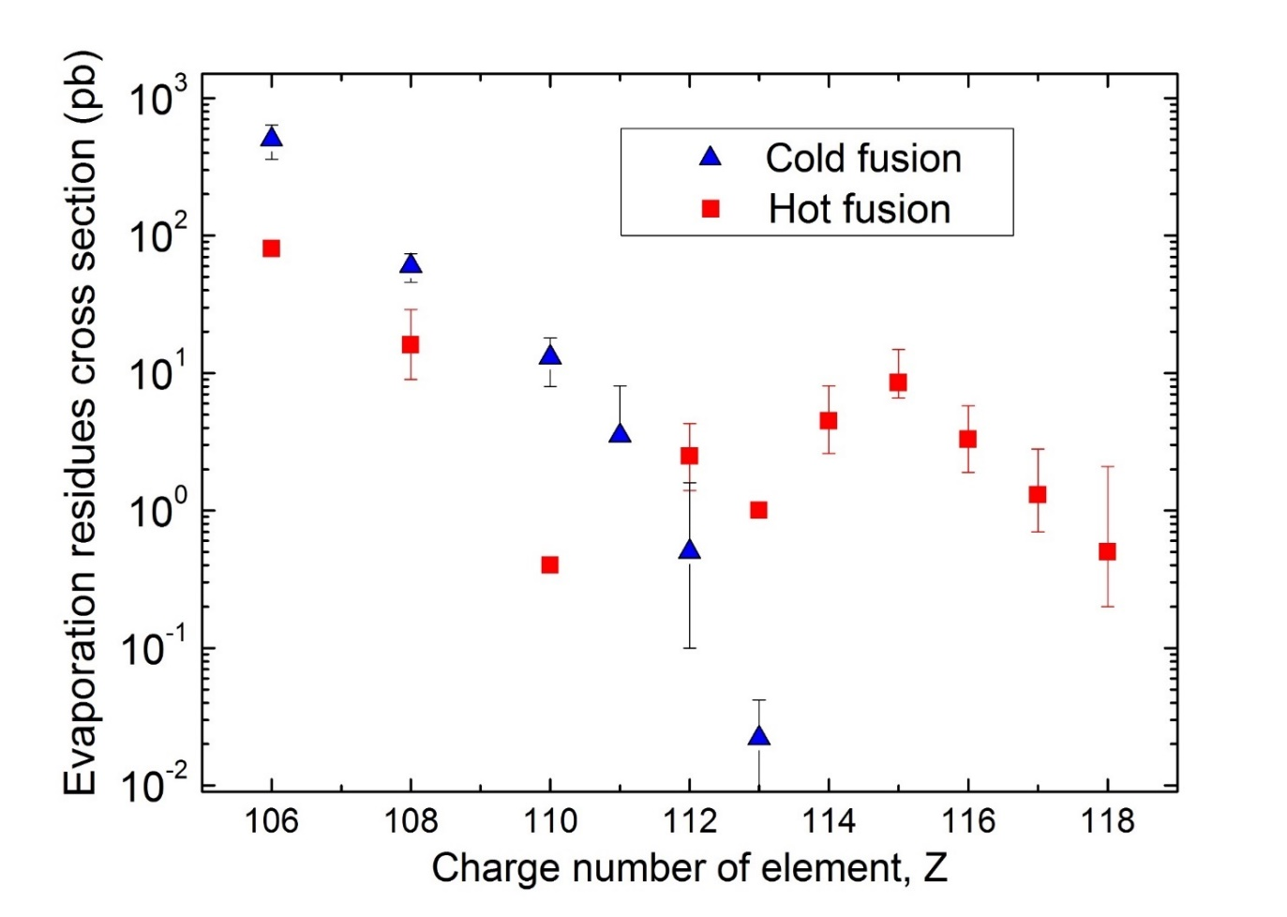
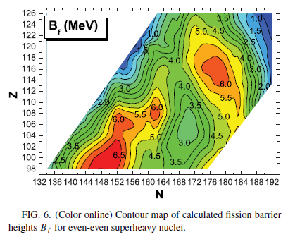
Differences in the cross sections of the evaporation residues of the same superheavy elements, obtained
for cold and hot fusion reactions, shows the dependence of the fission barrier on neutron numbers.
Fission barrier of the superheavy elements
as a function of their neutron numbers.
⁶⁴Ni+²⁰⁸Pb,
Nc=162
⁴⁸Ca+²³⁷Np
Nc=172
⁴⁸Ca+²³²Th
Nc=170
⁶⁴Ni+²⁰⁹Bi, Nc=160
M. Kowal et al, Phys. Rev. C 82, 014303 (2010).

Slide 10
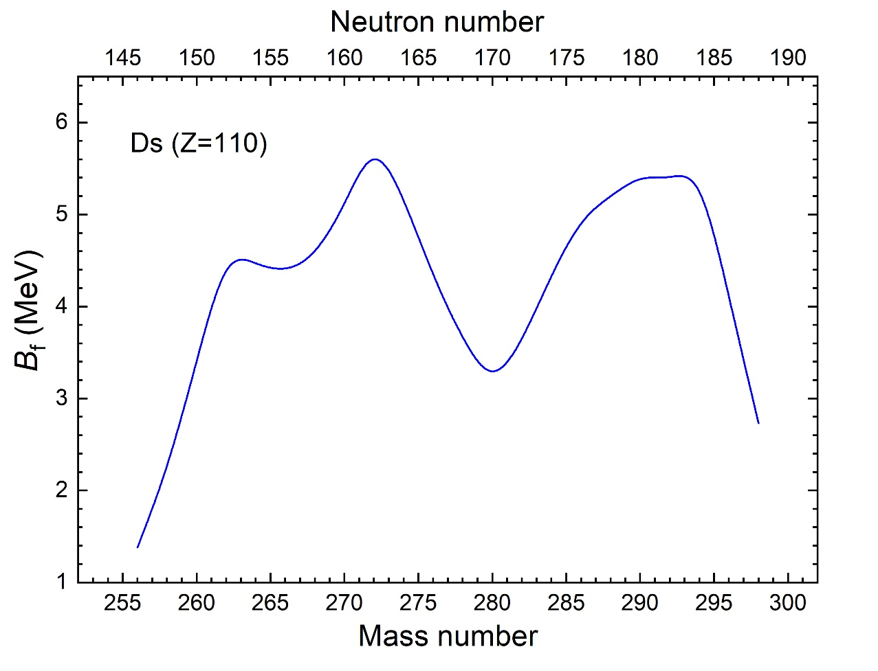
Differences in the cross sections of the evaporation residues of the same superheavy elements, obtained
for cold and hot fusion reactions, shows the dependence of the fission barrier on neutron numbers.
PHYSICAL REVIEW C 110, 014618 (2024)
A.K.N., A. R. Yusupov, and B. M. Kayumov. Small cross section of
the synthesis of darmstadtium in the ⁴⁸Ca+²³²Th reaction.
Fission barrier of the superheavy elements
as a function of their neutron numbers.
N_{comp}=160
N_{comp}=170
⁶⁴Ni+²⁰⁸Pb,
Nc=162
⁴⁸Ca+²³⁷Np
Nc=172
⁴⁸Ca+²³²Th
Nc=170
⁶⁴Ni+²⁰⁹Bi, Nc=160

Slide 11
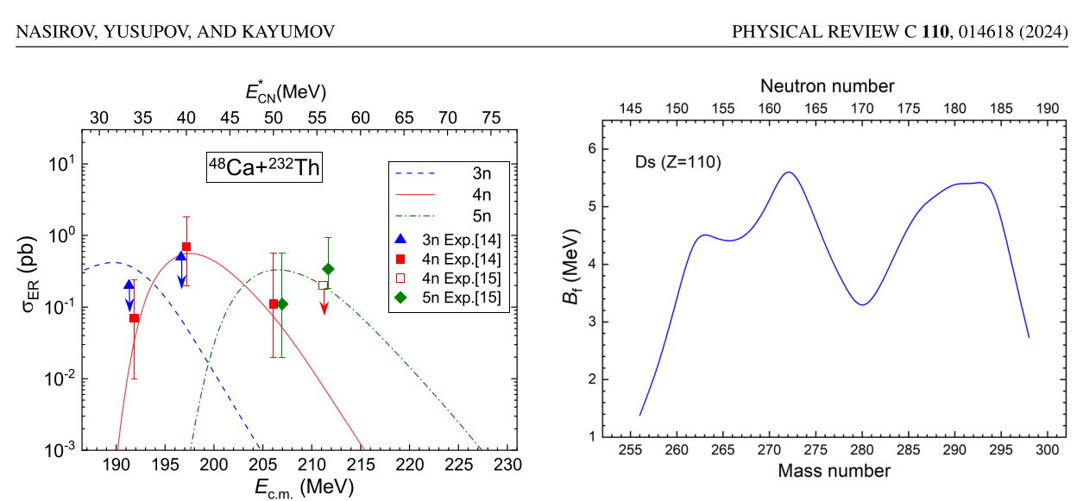

Slide 12

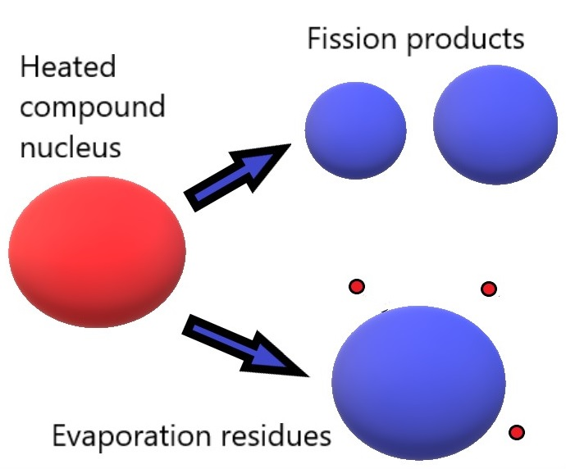
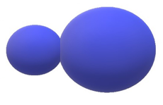





Reasons causing a difference in the synthesis of the superheavy elements in the cold and hot complete fusion channels.
Fusion
Quasifission
$$P_{CN}\sim e^{\frac{B_{qf}−B_{fus}^{∗}}{T_{DNS}}}$$
$$W_{surv}\sim e^{\frac{{B_{fis}−B}_{n}}{T_{CN}}}$$
$P_{CN}^{}$ (cold fusion) ≪${ P}_{CN}^{}$(hot fusion)
$W_{surv}^{}$ (cold fusion) ≫ $W_{surv}^{}$(hot fusion)
$B_{fus}^{∗}$ (cold fusion) >${ B}_{fus}^{∗}$ (hot fusion)
N.V. Antonenko, et al. PRC 51, (1995) 2635.
G.G. Adamian et al. NPA 678 (2000) 24.
G. Giardina et al. EPJA 8, (2000) 205.
$B_{fis}^{}$ (cold fusion) >${ B}_{fis}^{}$ (hot fusion)

Slide 13
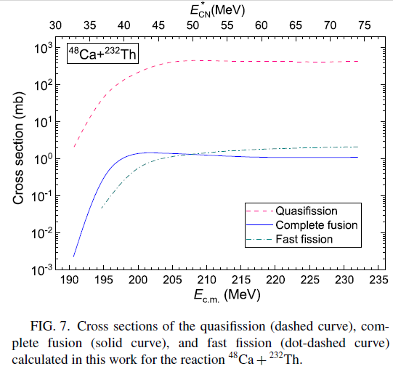
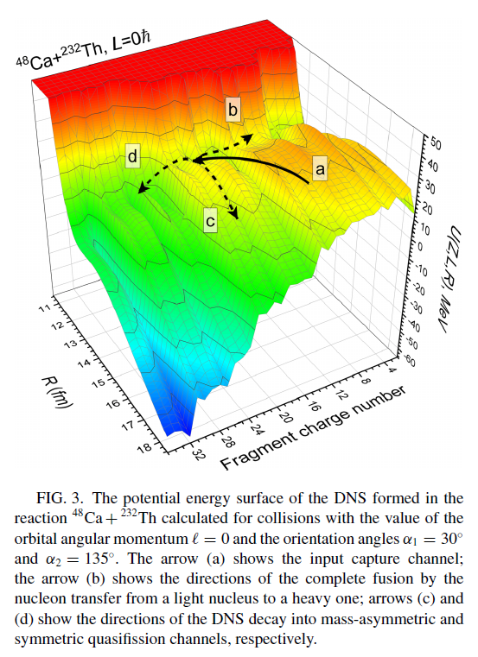
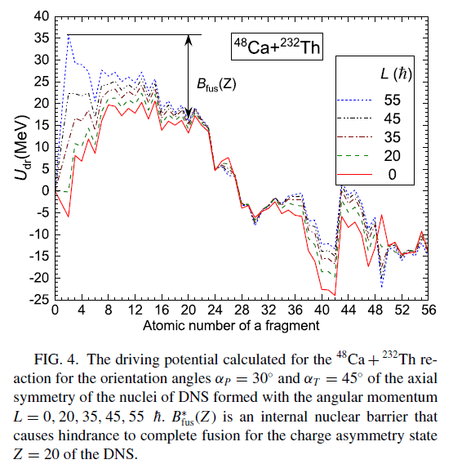
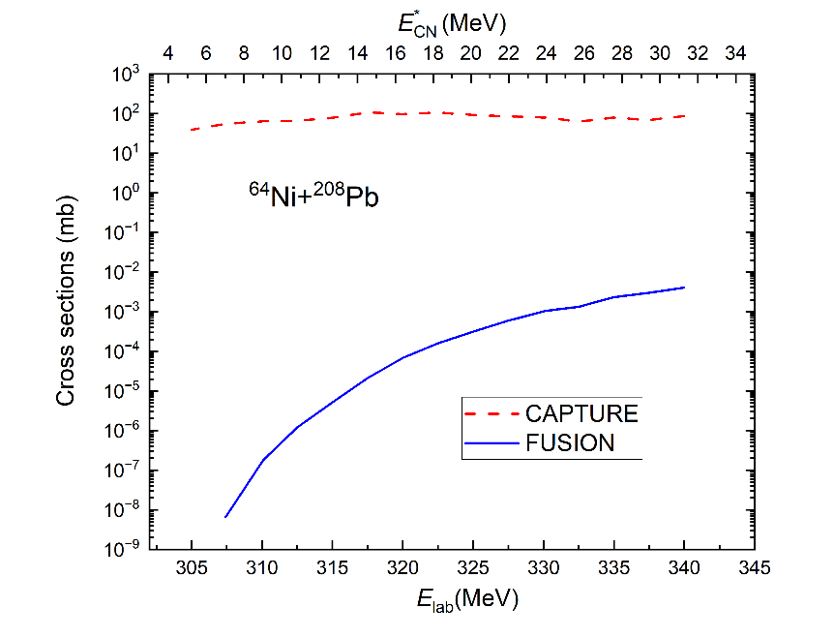


Role of the potential energy surface in calculation of the fusion probability.

Slide 14
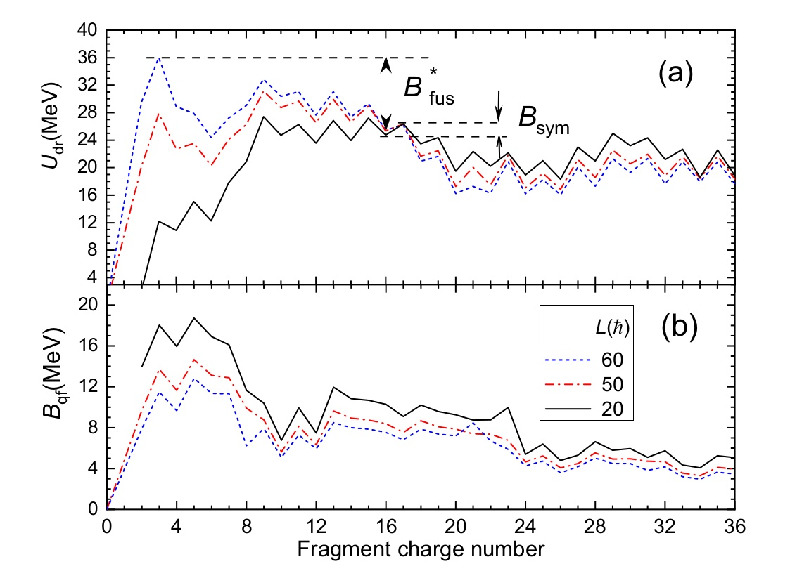
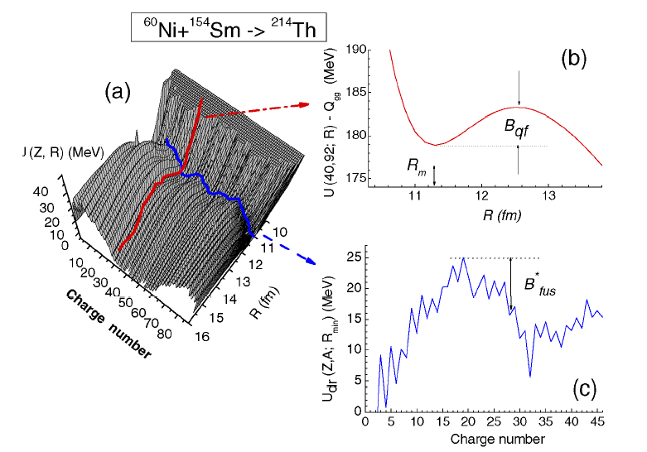
Influence of the rotational energy of the dinuclear system on the nucleon transfer process.

Slide 15
Calculation of the competition between complete fusion and quasifission: P_{cn}(E_{DNS},L). Influence of the nuclear shell effects are in intrinsic barrier B*_{fus} and in Y_{Z} charge (mass) distributions.
E_{c.m}
E*_{DNS}
E*_{DNS}(Z)=E_{c.m.}-V_{min}(Z)+(B_{P}+B_{T}) -(B_{Z}+B_{Ztot-Z})
Nasirov A.K. et al. Nuclear Physics A 759 (2005) 342.
Fazio G. et al, Modern Phys. Lett. A 20 (2005) p.391

Slide 16
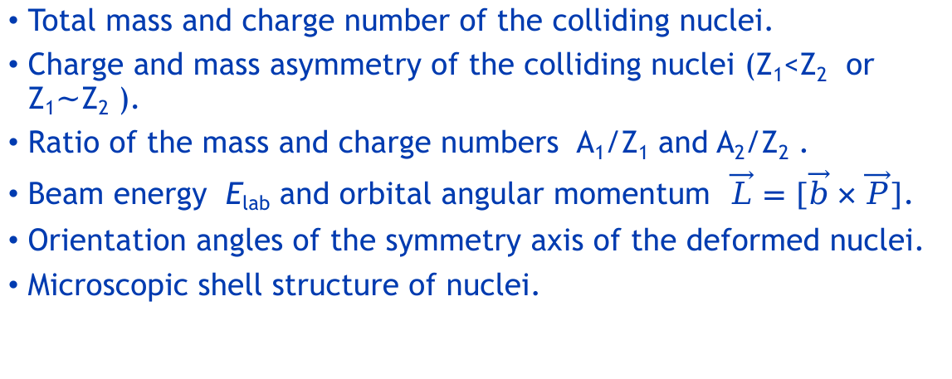
Main characteristics of the entrance channel of the nuclear reactions
Total mass and charge number of the colliding nuclei.
Charge and mass asymmetry of the colliding nuclei (Z₁<Z₂ or Z₁$\sim$Z₂ ).
Ratio of the mass and charge numbers A₁/Z₁ and A₂/Z₂ .
Beam energy E_{lab} and orbital angular momentum $\vec{L}=[\vec{b}×\vec{P}]$.
Orientation angles of the symmetry axis of the deformed nuclei.
Microscopic shell structure of nuclei.

Slide 17
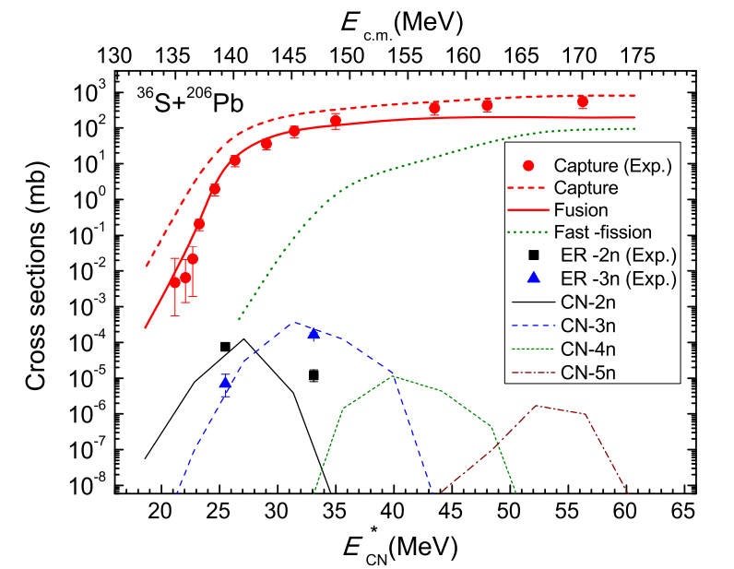
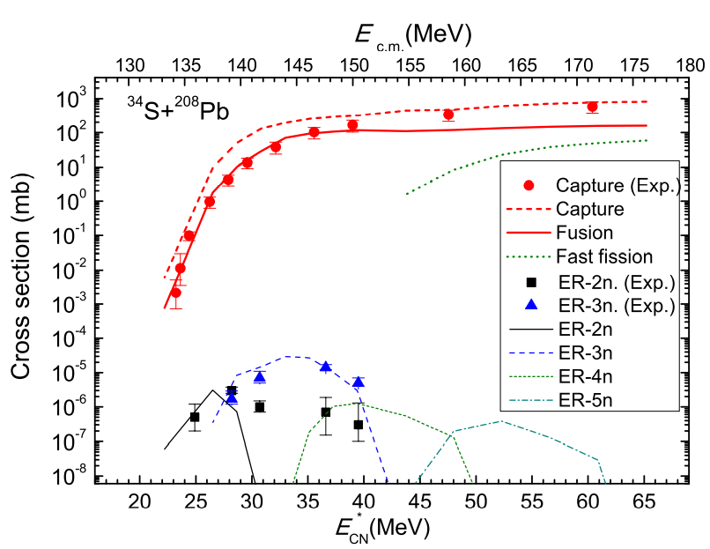
The difference in the evaporation residues (ER) of the ³⁴S + ²⁰⁸Pb and ³⁶S + ²⁰⁶Pb reactions formed in the 2n and 3n channels has been explained by two reasons: i) the capture cross section of the ³⁶S + ²⁰⁶Pb reaction is larger than the one of the ³⁴S + ²⁰⁸Pb reaction since the nucleus-nucleus potential is more attractive in the ³⁶S + ²⁰⁶Pb. Ii) the intrinsic fusion barrier B∗_{fus} for the ³⁴S ⁺ ²⁰⁸Pb reaction is higher than the one obtained for the ³⁶S + ²⁰⁶Pb reaction.
Experiment (symbols)
1. J. Khuyagbaatar et al,
Phys. Rev. C 86, 064602 (2012)
2. J. Khuyagbaatar et al,
Phys. Rev. C 91, 054608 (2015).
Theory (curves)
A.K. Nasirov et al.
Eur. Phys. J. A (2019) 55: 29

Slide 18
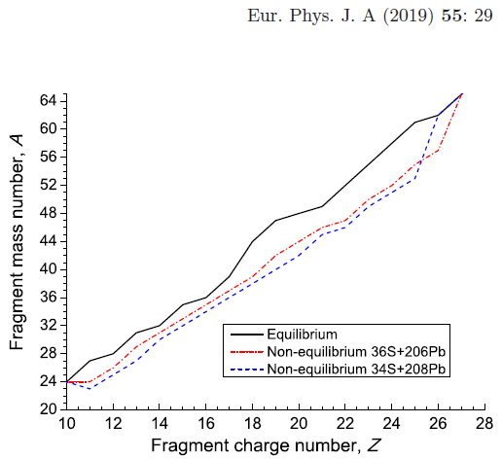
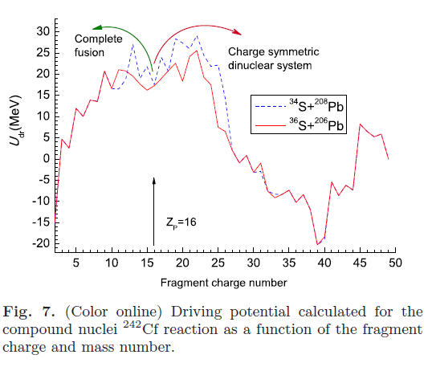
Role of the non-equilibrium stage of the entrance channel in formation of the compound nucleus.

Slide 19
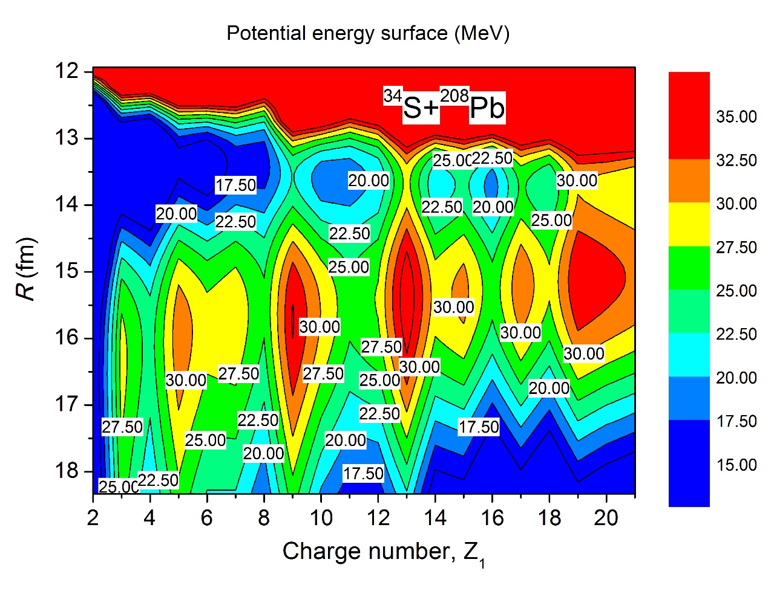
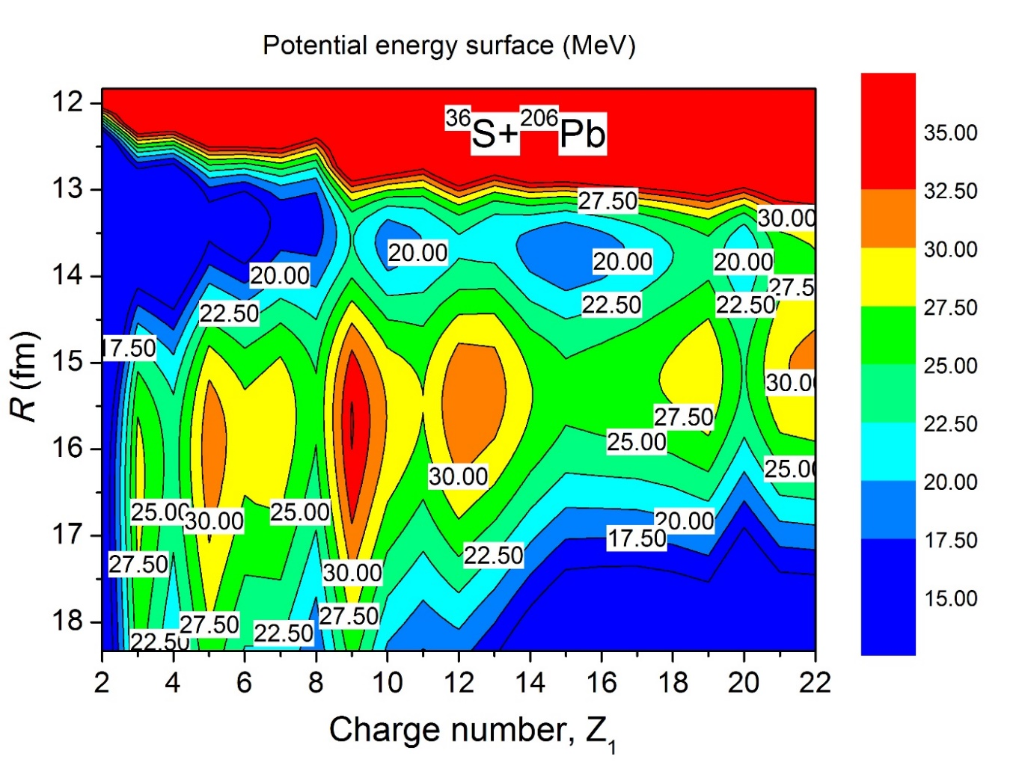
Comparison of the potential energy surfaces ruling complete fusion in the of ³⁴S+²⁰⁸Pb and ³⁶S+²⁰⁶Pb reactions

Slide 20
Reaction channels leading to yield of the binary products.
1. Quasifission
2.Incomplete fusion

Slide 21
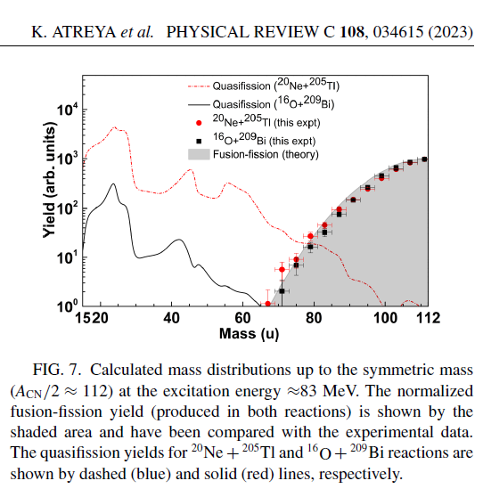
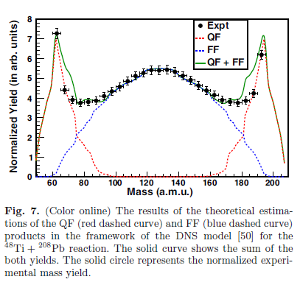
Attempts to analyze the results of the mixed contributions of the fusion-fission and quasifission products
Meenu Thakur et al., Eur. Phys. J. A (2017) 53: 133

Slide 22
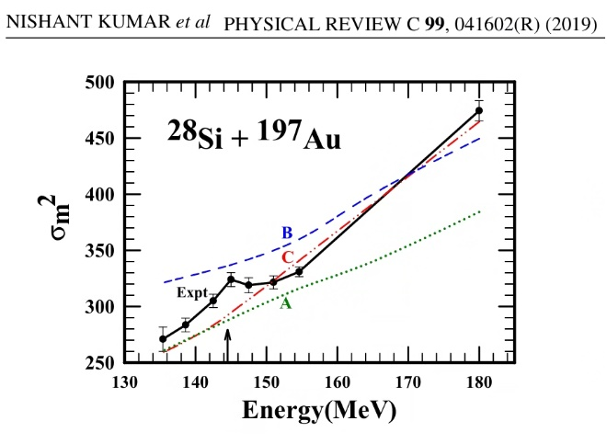
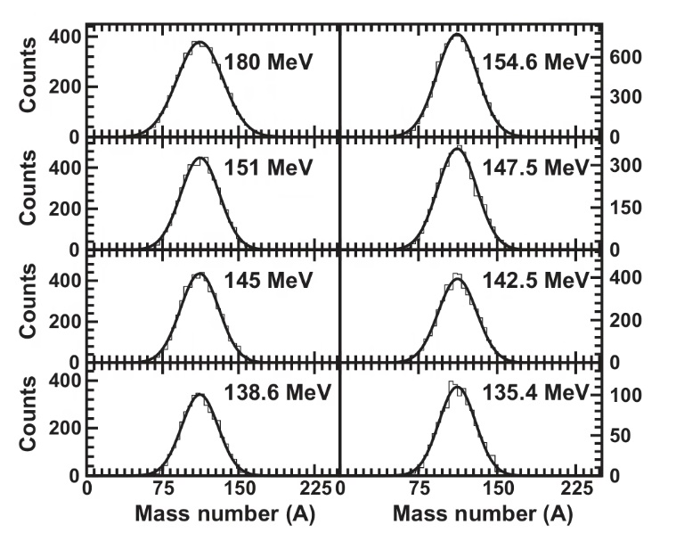
Role of quasifission in fission fragment mass distributions for the ²⁸Si + ¹⁹⁷Au reaction.
σ_{m}

Slide 23
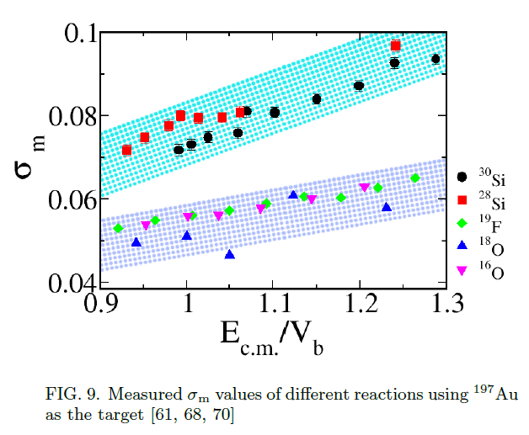
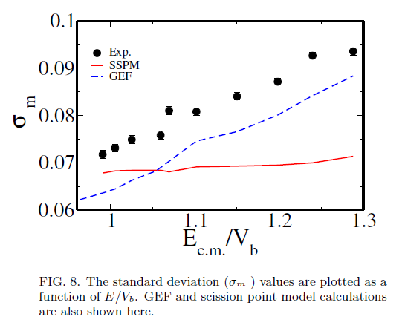
The role of the quasifission contribution in the dependence of the width of the mass distribution of fission-like products on the collision energy.
B. Ashna, M. Shareef, A. Shamlath, P. V. Laveen, … “Fission and quasission studies in ³⁰Si+¹⁹⁷Au reaction”

Slide 24
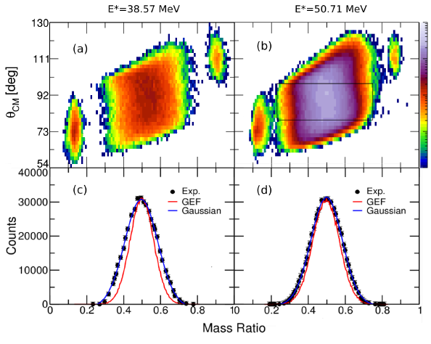
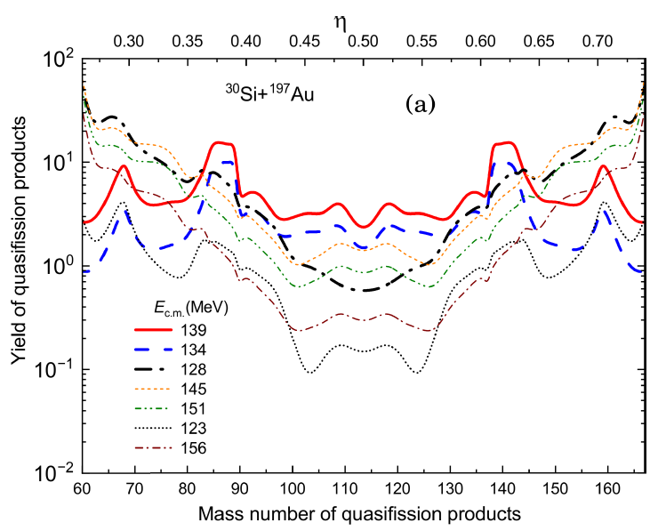
The role of the quasifission contribution in the dependence of the width of the mass distribution of fission-like products on the collision energy.
B. Ashna, M. Shareef, A. Shamlath, P. V. Laveen, … “Fission and quasission studies in ³⁰Si+¹⁹⁷Au reaction”

Slide 25
Dependence of Dinuclear system life time on the beam energy and orbital angular momentum L
30Si+197Au
Elab
L 190.0 185.0 180.0 175.0 170.0 165.0 160.0 155.0 150.0 145.0 140.0
70 0.9105E+01 0.4341E+02 0.3061E+01 0.4258E+01 0.0000E+00 0.0000E+00 0.0000E+00 0.0000E+00 0.0000E+00 0.0000E+00 0.0000E+00
65 0.2029E+02 0.5887E+01 0.6606E+01 0.5872E+02 0.1681E+02 0.0000E+00 0.0000E+00 0.0000E+00 0.0000E+00 0.0000E+00 0.0000E+00
60 0.1561E+02 0.3196E+02 0.1472E+02 0.2746E+02 0.4343E+02 0.5388E+03 0.0000E+00 0.0000E+00 0.0000E+00 0.0000E+00 0.0000E+00
55 0.1441E+02 0.1161E+02 0.3612E+02 0.2818E+02 0.7451E+02 0.2071E+03 0.4970E+03 0.7375E+19 0.0000E+00 0.0000E+00 0.0000E+00
50 0.1019E+02 0.2467E+02 0.2201E+02 0.2017E+02 0.1191E+03 0.1451E+03 0.8117E+03 0.9076E+04 0.4644E+17 0.0000E+00 0.0000E+00
45 0.7683E+01 0.1517E+02 0.1157E+02 0.3481E+02 0.4129E+02 0.5358E+02 0.6851E+03 0.1632E+04 0.8287E+05 0.0000E+00 0.0000E+00
40 0.7135E+01 0.1156E+02 0.7487E+01 0.1683E+02 0.1368E+02 0.6253E+02 0.1086E+03 0.3244E+03 0.2456E+04 0.1108E+07 0.0000E+00
35 0.8772E+01 0.1266E+02 0.1900E+02 0.1196E+02 0.2365E+02 0.2047E+02 0.8433E+02 0.1650E+03 0.8488E+03 0.2777E+05 0.3797E+08
30 0.1278E+02 0.1628E+02 0.8887E+01 0.1297E+02 0.2078E+02 0.3812E+02 0.3108E+02 0.2853E+02 0.2426E+03 0.1957E+04 0.2178E+05
25 0.1958E+02 0.9918E+01 0.1259E+02 0.1740E+02 0.2487E+02 0.3872E+02 0.2309E+02 0.5519E+02 0.4802E+02 0.4306E+03 0.6986E+04
20 0.1252E+02 0.1505E+02 0.1862E+02 0.2382E+02 0.3181E+02 0.4826E+02 0.2634E+02 0.4738E+02 0.1138E+03 0.1044E+03 0.1273E+04
15 0.1735E+02 0.2176E+02 0.2631E+02 0.3277E+02 0.4264E+02 0.2075E+02 0.3026E+02 0.5124E+02 0.9837E+02 0.5993E+02 0.2869E+03
10 0.2498E+02 0.2917E+02 0.3627E+02 0.4383E+02 0.5500E+02 0.2622E+02 0.3573E+02 0.5264E+02 0.8777E+02 0.1925E+03 0.5989E+03
5 0.3630E+02 0.4140E+02 0.4804E+02 0.5695E+02 0.2632E+02 0.3228E+02 0.4440E+02 0.6049E+02 0.9003E+02 0.1548E+03 0.3384E+03
0 0.2438E+02 0.2715E+02 0.3063E+02 0.3512E+02 0.4109E+02 0.4933E+02 0.6124E+02 0.7955E+02 0.1101E+03 0.1676E+03 0.2966E+03

Slide 26
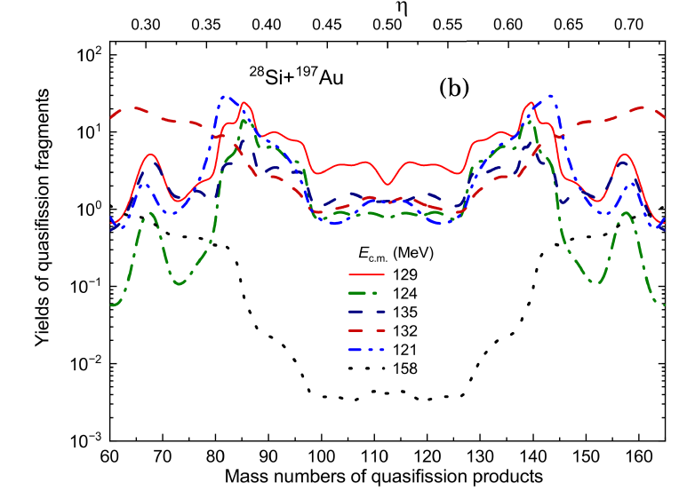
The role of the quasifission contribution in the dependence of the width of the mass distribution of fission-like products on the collision energy.
B. Ashna, M. Shareef, A. Shamlath, P. V. Laveen, … “Fission and quasission studies in ³⁰Si+¹⁹⁷Au reaction”
E_{lab}

Slide 27
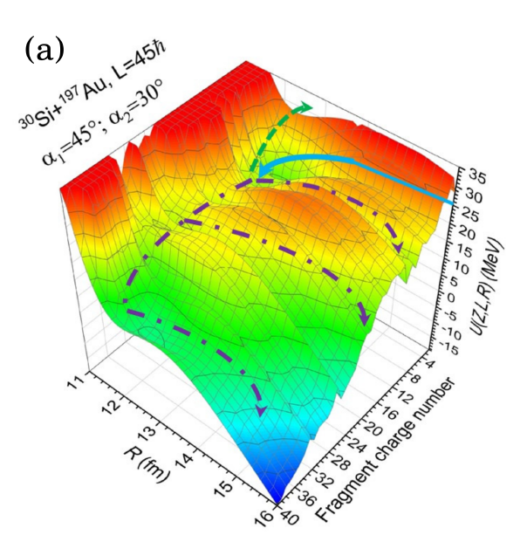
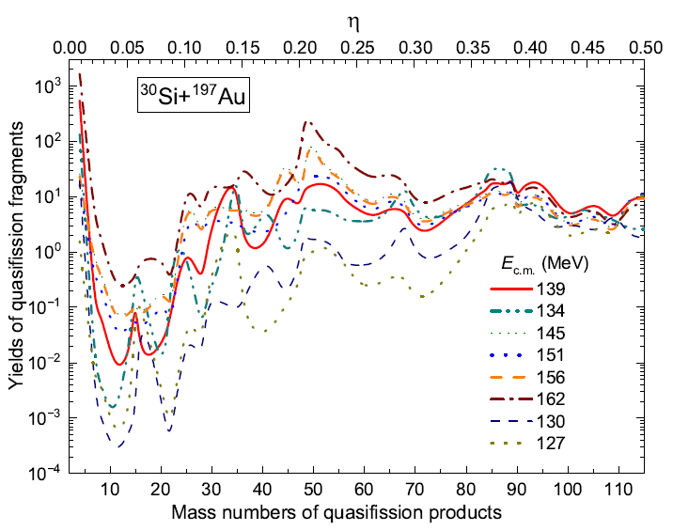
Interpretation of the largest contribution of the quasifission products to the mass symmetric region at collision energy E_{c.m.}=139 MeV.

Slide 28
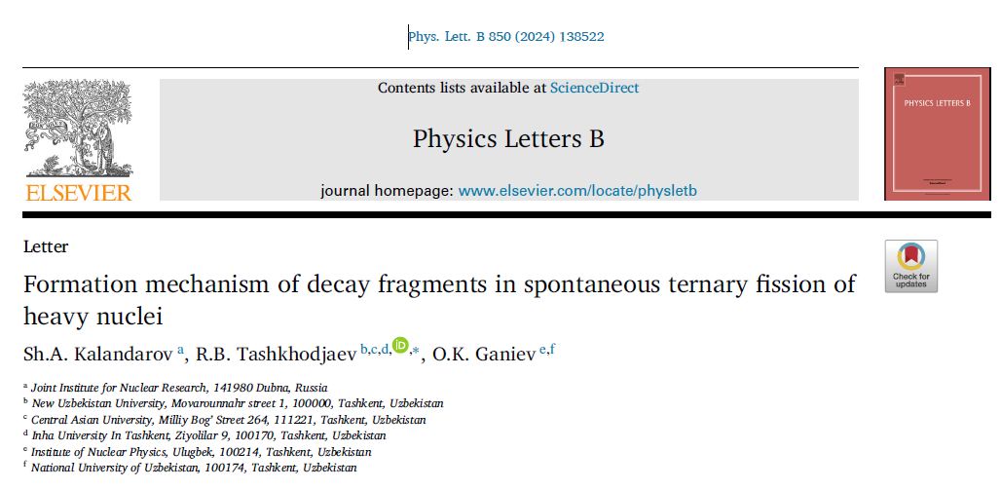
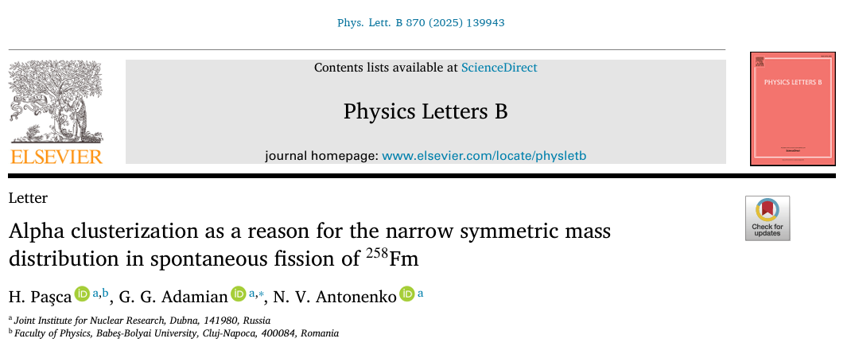


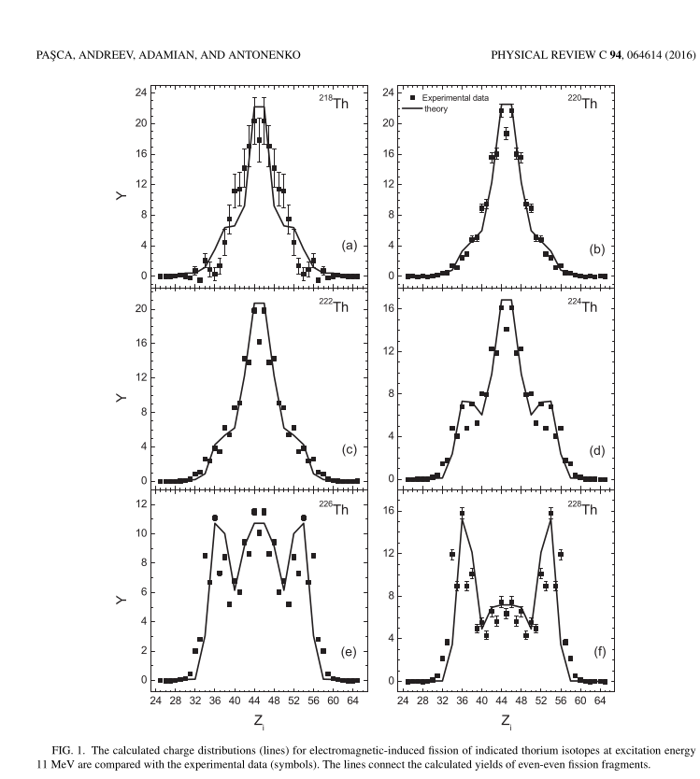
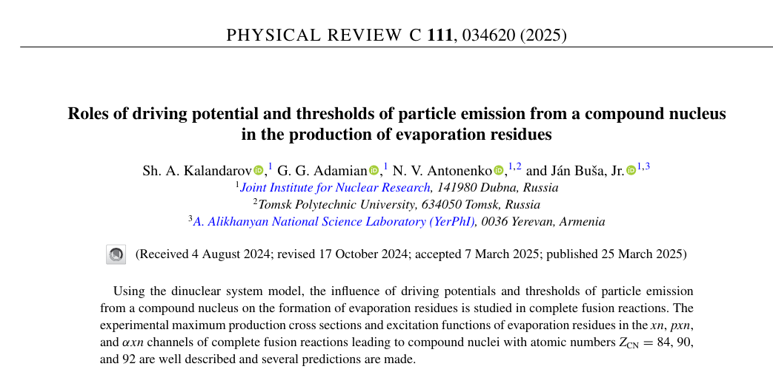

Slide 29
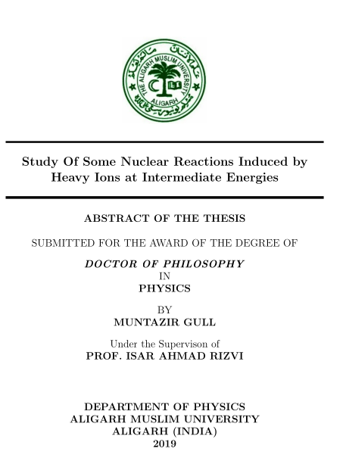
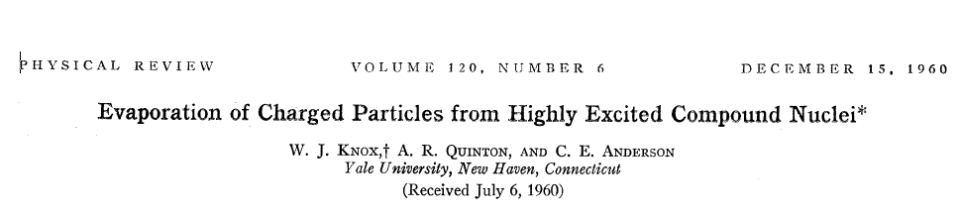
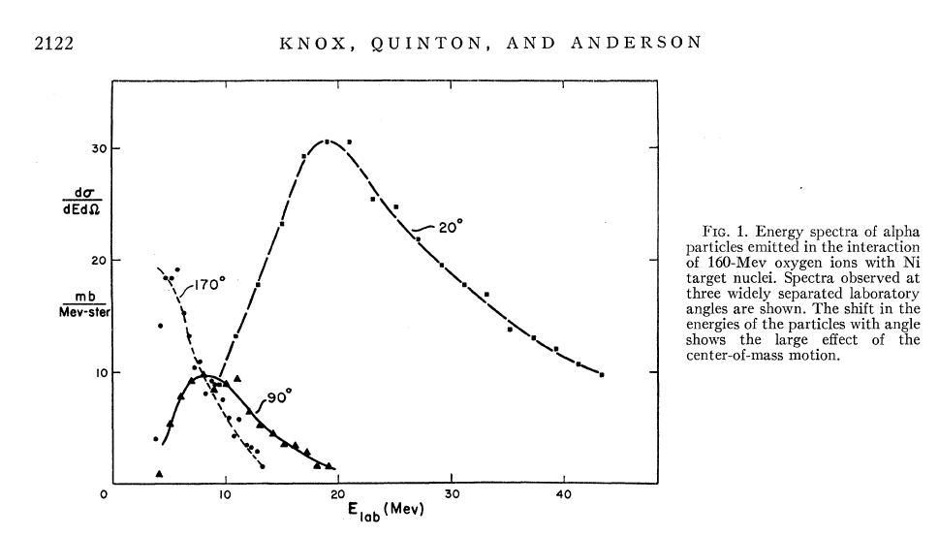
Nasirov, A. K., B. M. Kayumov, O. K. Ganiev and G. A. Yuldasheva . "A new dynamical mechanism of incomplete fusion in heavy-ion collisions." Physics Letters B 842: 137976 (2023).
W.J. Knox, A.R. Quinton, C.E. Anderson, Phys. Rev. 120 (1960) 2120

Slide 30



Role of the orbital angular momentum in the reaction mechanism.
$$\vec{L1}=[\vec{b1} ×\vec{P}]$$
E*_{DNS}
Incomplete fusion
¹⁸O
P
¹⁸O
⁴He
E*’_{DNS}
E*’’_{DNS}
⁴He
b₁
¹⁶⁵Ho
¹⁶⁵Ho
$$b1 >b2$$
¹⁷⁹Ta
E*_{DNS}
$$\vec{L2}=[\vec{b}2×\vec{P}]$$
Complete fusion
¹⁸O
¹⁸O
⁴He
E*’_{DNS}
E*_{CN}
P
b₂
¹⁶⁵Ho
¹⁸³Re
¹⁶⁵Ho
¹⁷⁹Ta

Slide 31
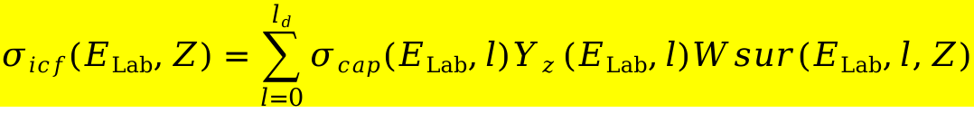
A.K. Nasurov et al. Physics Letters B 842: 137976 (2023)
$$\vec{L1}=[\vec{b1} ×\vec{P}]$$
E*_{DNS}
Incomplete fusion
¹⁸O
P
¹⁸O
⁴He
E*’_{DNS}
E*’’_{DNS}
⁴He
b₁
¹⁶⁵Ho
¹⁶⁵Ho
¹⁷⁹Ta
Calculation of the incomplete fusion cross section
$$σicf\left(ELab,Z\right)=\sum_{l=0}^{ld}{σcap\left(ELab,l\right)Yz}(ELab,l)Wsur(ELab,l,Z)$$

Slide 32



The role of the orbital angular momentum
U(Z,A,L,R)=V_{coul}(Z,A,R)+V_{nucl}(Z,A,R,L)+V_{rot}(Z,A,R,L)+Q_{gg}(Z,A)-$V_{rot}^{\left(CN\right)}(L)$
$$V_{rot}^{}\left(Z,A,R_{min}^{},L\right)=\frac{l\left(l+1\right)ℏ^{2}}{{2J}_{DNS}(Z,A,R_{min}^{})}$$
A,Z
Conjugate
nucleus
$$R_{min}^{}$$
A_{C}, Z_{C}
$$\vec{L}$$
$J_{DNS}\left(Z,A,R_{min}^{}\right)=μ_{Z}R_{min}^{2}$+$\left(J_{1}\left(Z,A\right)+J_{2}\left(Z_{C},A_{C}\right)\right)/2$

Slide 33
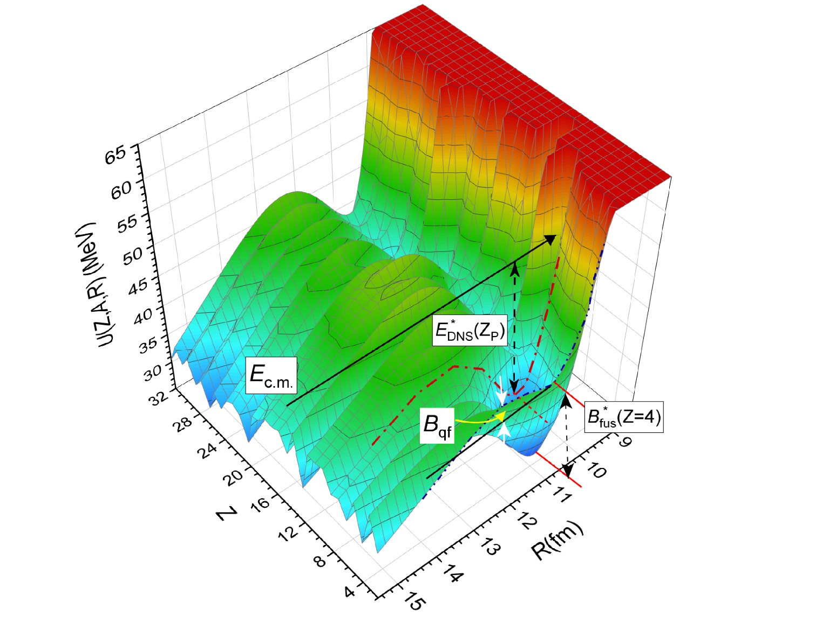
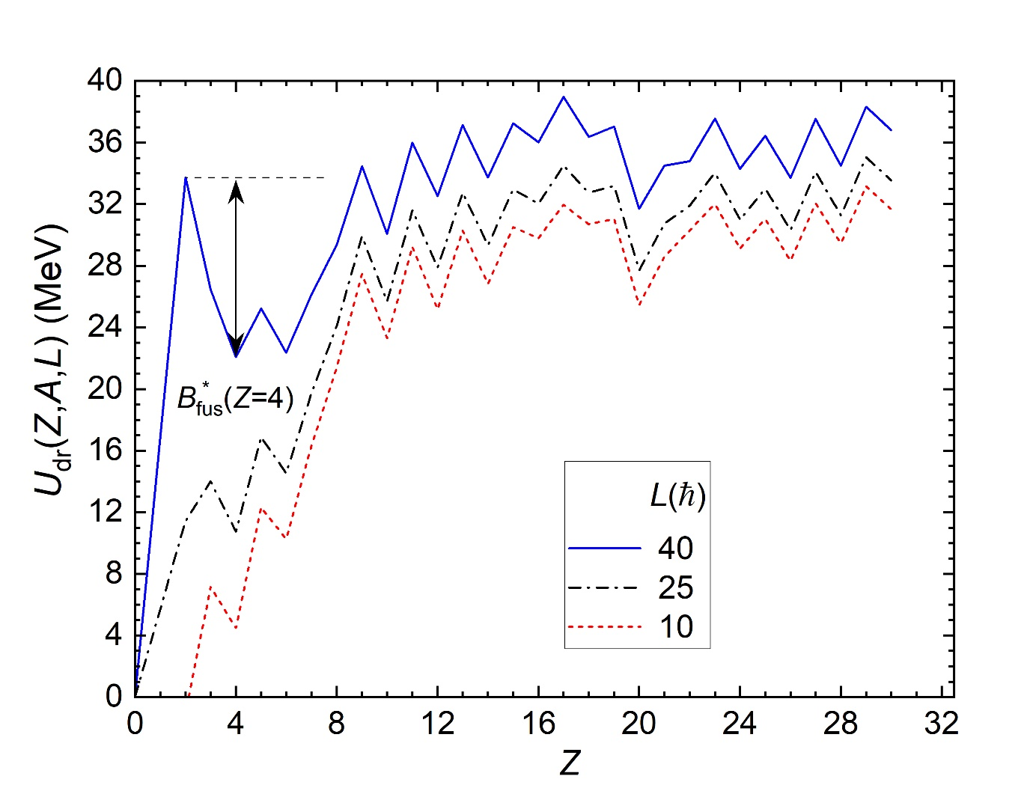
¹⁶O+¹³⁰Te
Driving potential
Potential energy surface

Slide 34
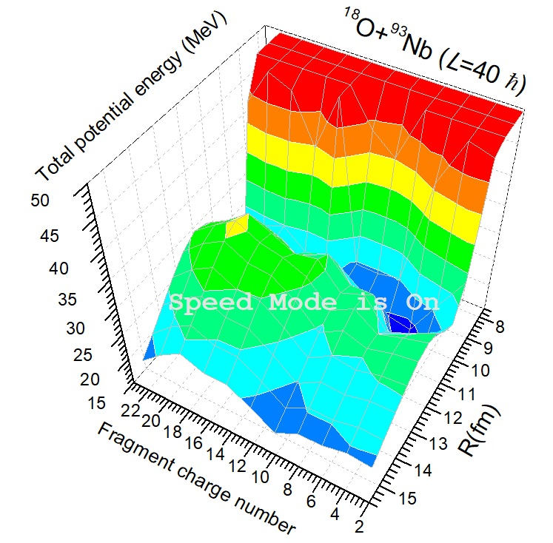
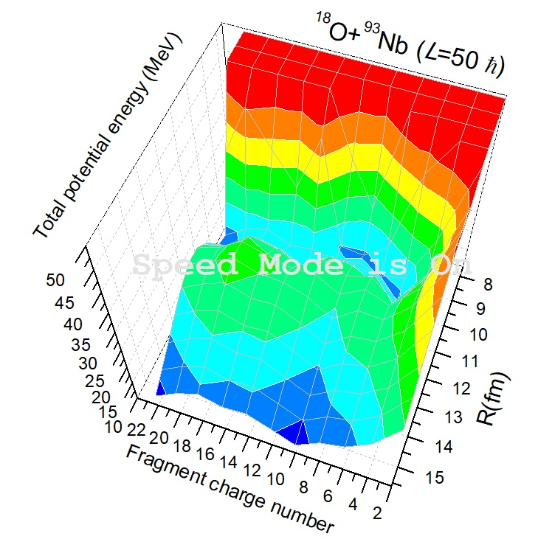
Appearance of the hindrance to complete fusion
Appearance of the hindrance to complete fusion Phys. Lett. B 842: 137976 (2023)
E*_{DNS}(Z)=E_{c.m.}-V_{min}+(B_{P}+B_{T}) -(B_{Z}+B_{ztot-z})
E*_{DNS}(Z)=E*_{Z}

Slide 35

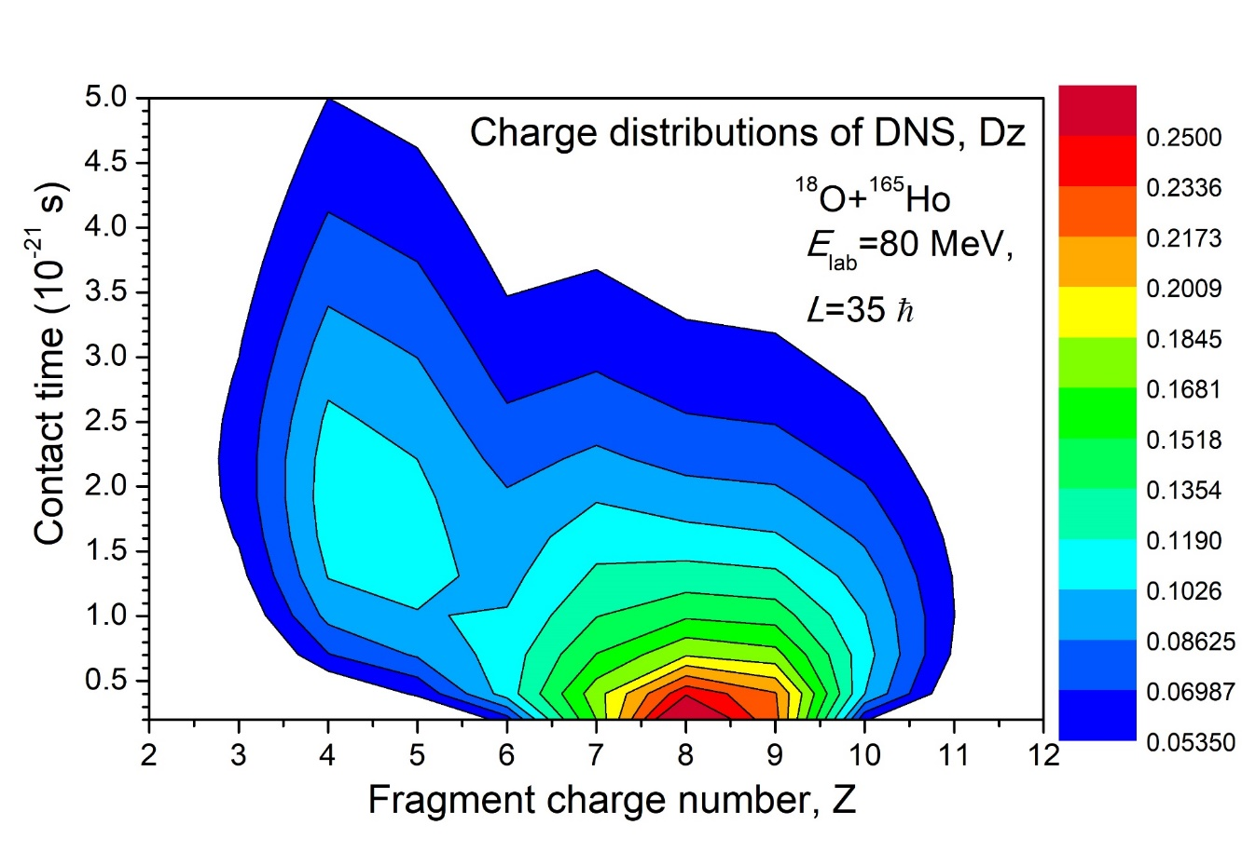
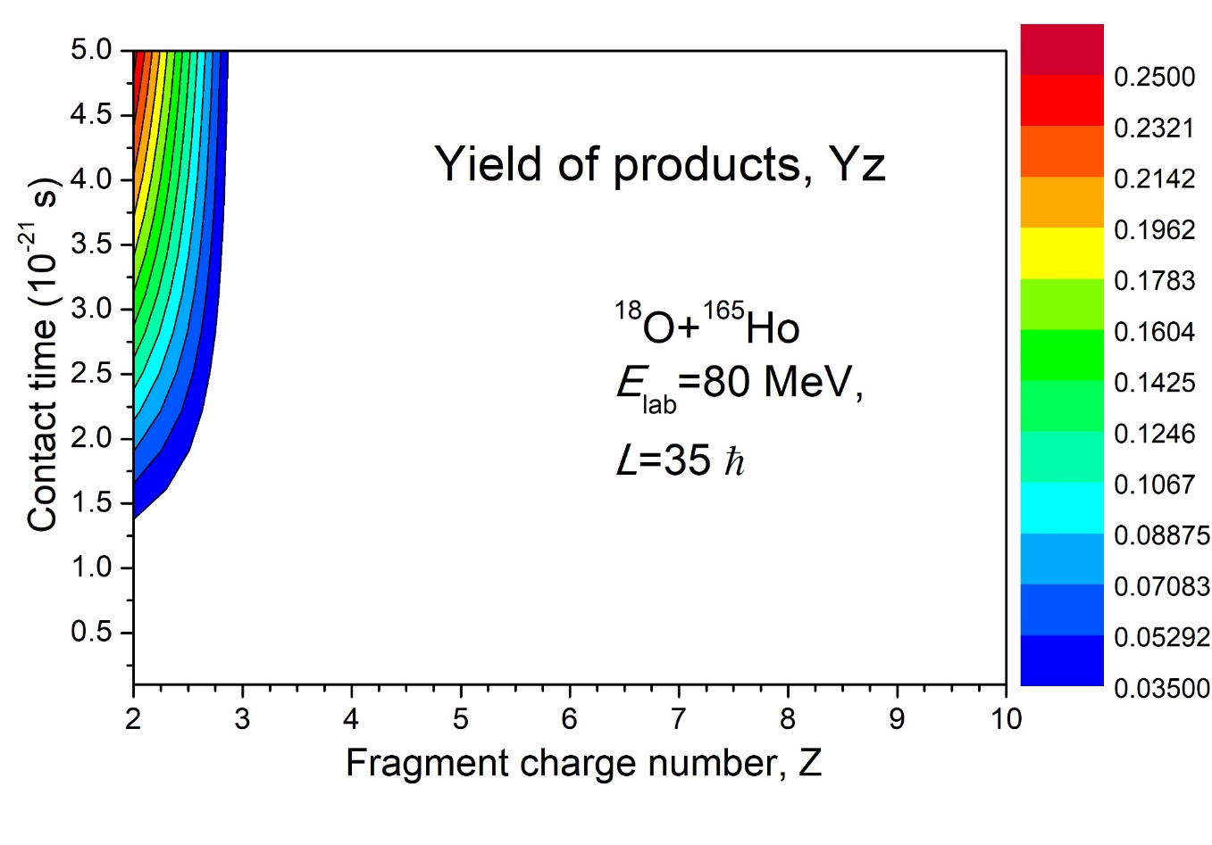
Solutions of the transport master equations for the evolution and decay dinuclear system formed in reaction ¹⁸O+¹⁶⁵Ho
D_{Z}

Slide 36
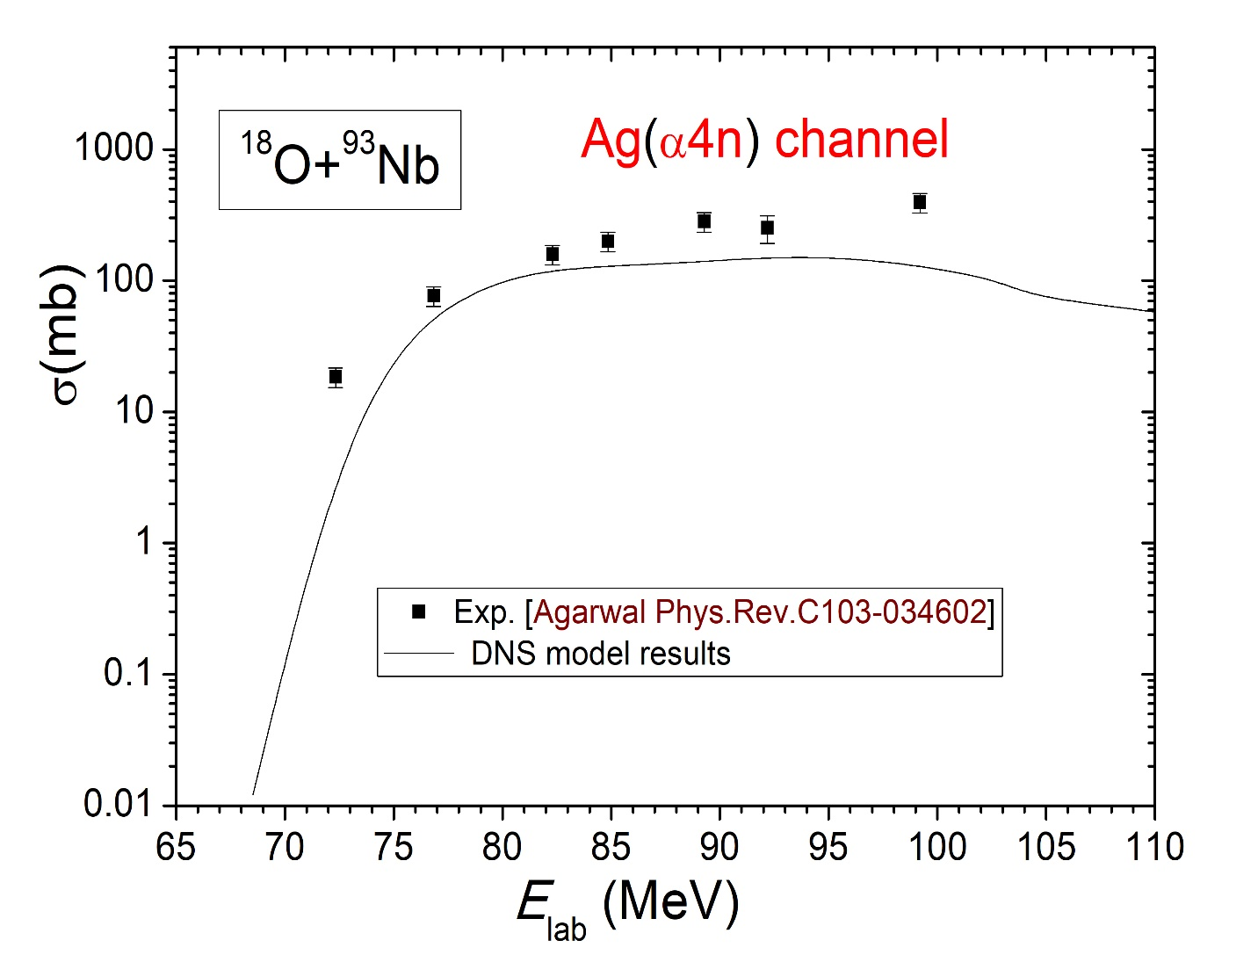

Avinash Agarwal, Phys.Rev.C103-034602 (2021)
Comparison of the results by dinuclear system model and PACE4 code.
Theoretical result of this work

Slide 37


Comparison of the results by dinuclear system model and PACE4 code.
Theoretical result of this work
Avinash Agarwal, Phys.Rev.C103-034602 (2021)]

Slide 38




$$σicf\left(ELab,Z\right)=\sum_{l=0}^{ld}{σcap\left(ELab,l\right)Yz}(ELab,l)Wsur(ELab,l,Z)$$

Slide 39






Calculation of the evolution of the charge distribution between fragments of the dinuclear system
$$\frac{∂D_{Z}\left(E_{Z}^{∗},l,t\right)}{∂t}=∆_{Z+1}^{(−)}D_{Z+1}\left(E_{Z}^{∗},l,t\right)+∆_{Z−1}^{(+)}D_{Z−1}\left(E_{Z}^{∗},l,t\right)−\left(∆_{Z}^{(−)}+∆_{Z}^{(+)}−Λ_{Z}\left(B_{qf}^{(Z)},T_{Z}\right)\right)D_{Z}\left(E_{Z}^{∗},l,t\right)$$
$$Λ_{Z}\left(B_{qf}^{(Z)},T_{Z}\right)=\frac{Γ_{Z}}{2π}\frac{ω_{m}}{ω_{qf}}exp\left(\frac{−B_{qf}^{(Z)}}{T_{Z}}\right),$$
$Γ_{Z}$=$\sqrt{{\left(\frac{γ}{{2μ}_{Z}}\right)}^{2}+ω_{qf}^{2}}−\frac{γ}{{2μ}_{Z}}$
γ = 8 · 10 ⁻ ²² MeV sec ⁻ ¹
$$ω_{qf}$$
T _{Z} ( A , L ) = $\sqrt{\frac{E_{Z}^{∗}}{a}}$ a = $\frac{A_{tot}}{12}$ MeV⁻¹
$$ω_{m}$$
Nasirov A.K. et al. Nuclear Physics A 759 (2005) 342–369
Fazio G. et al, Modern Phys. Lett. A 20 (2005) p.391

Slide 40




Nucleon transfer coefficients for evolution of the charge asymmetry of dinuclear system
$$λ_{K}^{(α)}$$
$$ε_{i}$$
G.G. Adamian, et al. Phys. Rev. C53, (1996) p.871-879
R.V. Jolos et al., Eur. Phys. J. A 8, 115–124 (2000)

Slide 41
Conclusion
1. The study of the different reaction channels in heavy ion collisions
by the dinuclear system model allows us to find a reason of the
hindrance for complete fusion of the mass symmetric nuclei.
2. The hindrance to fusion increases by the increase of the angular momentum
of collision.
3. Complete fusion occurs by multinucleon transfer through the neck connecting
two fragments of dinuclear system.
4. The incomplete fusion is a quasifssion in the region of the very asymmetric
masses. Projectile nucleus breaks down after capture, not before capture.

Slide 42

Classical equations of the radial and tangential motions with the kinetic coefficients which are calculated microscopically.
$L_{0}=J_{R}\dot{θ}R+J_{1}\dot{θ}1$+$J_{2}\dot{θ}2$

Slide 43
Nucleus-nucleus interaction potential

Slide 44

Density dependent effective nucleon-nucleon forces
The values of the constants of the effective nucleon-nucleon forces from the textbook
A.B. Migdal, “Theory of the Finite Fermi-Systems and properties of Atomic Nuclei”,
Moscow, Nauka, 1983. The constants of version II were used in our calculations.

Slide 45

Classical equations of the radial and tangential motions
$L_{0}=J_{R}\dot{θ}R+J_{1}\dot{θ}1$+$J_{2}\dot{θ}2$

Slide 46
Hamiltonian for calculation of the transport coefficients
The macroscopic motion of nucleus and microscopic motion of nucleons must be calculated simultaneously.

Slide 47
Master equations for the nucleon occupation numbers and Equation of motion for the relative distance
(5)
(6)
(7)
(8)
(9)
. G.G. Adamian, et al. Phys. Rev. C53, (1996) p.871-879

Slide 48




Solutions for the density matrixes
and ${\hat{ω}}_{ki}=\left({\hat{ε}}_{k}−{\hat{ε}}_{i}\right)/ℏ$

Slide 49

Time evolution of the occupation numbers of protons and neutrons in interacting nuclei.
This is equilibrium occupation number.

Slide 50

Calculation of the physical quantities characterizing multinucleon transfer reactions

Slide 51

Friction coefficients
ε_{j} and ε_{k} are single particle energies of components of dinuclear system;
is a width of the excited single-particle states
due to residual interaction between nucleons.
G.G. Adamian, et al. Phys. Rev. C56 No.2, (1997) p.373-380

Slide 52



Width of the single-particle excited states
A. Nasirov et al, Nucl. Phys. A 759 (2005) 342–369
$$Γi=\frac{ℏ}{τ_{i}}$$
$E_{K}$ is excitation energy and mass number
of the fragment K
$$A_{K}$$
D. Pines, P. Noziéres, Theory of Quantum Liquids, Benjamin, New York, 1966

Slide 53

Constants of the effective nucleon-nucleon interaction (Migdal forces)

Slide 54
Comparison of the friction coefficients calculated by the different methods
-- Gross-Kalinovski
Solid line – semi-microscopic method
Linear response theory by Yamaji
Long dashed __
Short dashed.- -
Dotted ….
Temperature= 2 МэВ
Temperature = 1 МэВ
Temperature = 0.5 МэВ
Phys. Rev. C56 No.2, (1997) p.373-380

